Slide 1
How Arts and Culture Nonprofits Respond to COVID-19 Outbreak on Twitter
Hanjin Mao & Apoorva Gupta
Rutgers University – Newark
ARNOVA-Asia 2021
Notes:
Hello everyone, this paper is looking at the impact of covid-19 on social media engagement, specifically on the arts and culture nonprofits in the greater NY area. We are Hanjin Mao and Apoorva Gupta, doctoral students at Rutgers SPAA, Newark
We are looking at the question of what happens when the COVID-19 pandemic has disrupted vital nonprofit activities, how do nonprofit organizations react in their social media engagement?

Slide 2
Background
March 1: A New York woman, 39, returning from travel in Iran becomes the state's first COVID-19 case.
Major disruptions to the Nonprofit activities – suspended programs, loss of government contracts, canceled fundraising events (Kim & Mason, 2020)
Disproportionate impact on arts and culture nonprofits – perceived as less urgent in fundraising competition, depend on consumer spending and leisure activities (Walker, 2020, Grodach & Seman, 2013)
Notes:
For a brief background, the COVID-19 pandemic has brought major disruptions to nonprofit activities. Where many nonprofits had to suspend programs and delivery models, have lost government contracts, or canceled fundraising events
However, it has hit the arts and culture nonprofits particularly hard. Arts nonprofits often face additional pressure during economic downturns, given that they must compete for donations with human service organizations, whose needs are often perceived as more urgent.
This is particularly true in the metropolitan area of New York City, which was amongst the first to be affected by the virus and subsequently the pandemic mitigation lockdown strategies (Kim & Mason, 2020, Fraser 2020). Differences in funding environment and program demands meant that while some human services nonprofits might find themselves in higher demand and their needs are considered more urgent (Kulish, 2020), arts nonprofits must not compete with service-provision nonprofits for donations (Kim, 2017). Arts and culture organizations, on the other hand, depend mainly on consumer spending and leisure activities which makes them especially vulnerable to shocks like a pandemic (Grodach & Seman, 2013).
COVID-19 has presented additional challenges for arts nonprofits whose programs rely upon community gatherings and shared experience.
Given the disproportionate and immense impact of the COVID crisis on this section of nonprofits, it becomes imperative to understand the mitigation and communication strategies that arts and culture nonprofits might employ.

Slide 3
Literature Review - Why social media?
Fundraising: reach more potential donors (Waters, Burnett, Lamm, & Lucas, 2009), reducing information asymmetry (Lee, 2020)
Stakeholder Engagement: low-cost option for interactive two-way communication with diverse audience. Interact directly with their key stakeholders, without relying on media organizations as intermediaries (Campbell et al., 2014)
Effective crisis management needs: crises required timely coordination and spontaneous platforms. Social media allows clients to come together and share crucial resources and knowledge (Elbanna et al., 2019)
Notes:
So Why would we think about social media?
Social media has been claimed to be a positive force for nonprofits that can enhance, among other things, a nonprofit’s communication, marketing, fundraising, stakeholder engagement, knowledge acquisition, awareness building, volunteer management, accountability,
While the arts and culture nonprofits’ perspective on these outcomes is limited, a few studies point to the potential social media has for creating online communities and increasing their engagement.
Research on social media usage and impact for nonprofits can be categorized largely under two main effects - resource mobilization and fundraising, and stakeholder engagement. The third aspect deals with these benefits during a crisis.
For Fundraising, Social media helps reduce information asymmetry. As Nonprofits often operate in markets with high information asymmetry, where product or service quality cannot be observed before purchase or donation
Combined with a high level of information asymmetry, a positive “endorsement” from a trusted connection in a user’s network can play an important role in a potential donor’s charitable giving decision (Wiencierz, Pöppel, & Röttger, 2015). For social media websites like Facebook and Twitter, the “like” button allows users to communicate their approval of messages and pages Thus, this virtual endorsement suggests trustworthiness among the user's “friends” who might not have firsthand experience with the organization
●
In terms of Stakeholder Engagement - Social media represents a new medium for stakeholder relationship building, which is relatively low-cost and is interactive, two-way and geographically dispersed
This is particularly relevant in crisis communications situations. Social media can help enhance transparency while reducing “confusion and errors” (Veil et al., 2011). Digital technologies like two-way interaction through social media allow nonprofit organizations to interact directly with their key stakeholders, without relying on media organizations as intermediaries
In Effective crisis management, there is some empirical evidence that stakeholder engagement can be maximized through social media where it is as an efficient medium for organizations as Communication with key constituents during crises required timely coordination and spontaneous platforms (Elbanna et al., 2019). Crisis conditions like COVID-19 are complicated and dynamic, creating inefficiencies, capacity and resource constraints (Harrison & Johnson, 2019; Panagiotopoulos et al., 2014; Reddy et al., 2009). well as clients to come together and share crucial resources and knowledge. While the arts and culture nonprofits’ perspective on these outcomes is limited, a few studies point to the potential social media has for creating online communities and increasing their engagement. Gap in research.

Slide 4
Research Questions
How has COVID-19 impacted social media engagement for arts and culture nonprofits in the greater NY area?
Specifically,
How does COVID-19 change art nonprofits’ social media approach on Twitter?
How does the change impact their social media engagement?
Notes:
This study compares the social media activities by arts and culture nonprofits before and after COVID-19 outbreak to understand how nonprofit organizations respond to the crisis on social media during the challenging time. Focusing on the metropolitan area of New York City, the study seeks to analyze whether arts and culture nonprofits in the city act differently on Twitter to engage with key audiences during the COVID-19 pandemic. In particular, the authors aim to answer the following research questions:
●How does COVID-19 change art nonprofits’ social media approach on Twitter?
●How does the change impact their social media engagement?

Slide 5
Methodology
Sample: 41 art and culture organizations in NYC (filtered by 990 datasets, NTEE A5*)
Data: 20,821 Tweets from 41 organizational accounts from September 2019 to August 2020 (6 months pre-COVID & 6 months post-COVID)
Content Analysis Pre-COVID vs. Post-COVID
Descriptive Comparison & Regression
Key variables: number of tweets, number of retweets, number of likes
Notes:
The sample of our study is 41 art and culture organizations located in New York City. They are filtered by NTEE code that starts with A5 in the 990 dataset.
Then, we collected data from twitter timeline. There are 20,821 tweets from these 41 organizational accounts from September 2019 to August 2020. The time period is 6 months before COVID and 6 month after COVID outbreak.
The screenshot is an example of one tweet post.
We conduct two major analyses using the Twitter data. First, Qualitatively, we conduct a content analysis on the tweets text to compare common themes Pre-COVID and Post-COVID, with two text mining techniques - word frequency and topic modeling.
Second, Quantitatively, we did a descriptive comparison of the Post COVID change and then run regression analysis on individual organizational accounts to explore the relationship between social media input and engagement outcomes.
The key variables we investigated are number of tweets, number of retweets, number of likes.

Slide 6
Text Analysis
Notes:
Here are the results. First, Text analysis.

Slide 7
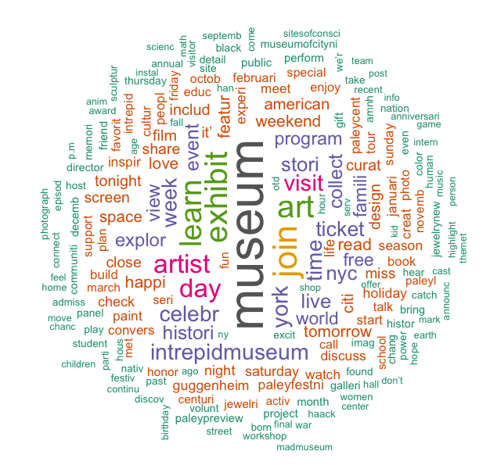
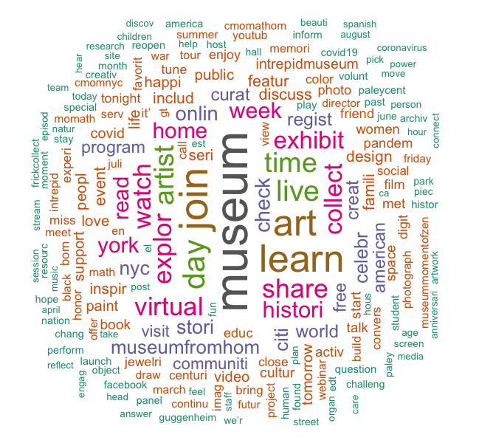
Pre-COVID vs. Post-COVID
Word Could
Notes:
Here is the wordcloud produced with all the tweets 6 month pre-covid vs. 6 month post-covid. The larger the font of the word, the more frequent it appears in the organizations’ tweet text.
Most of the top words remain the same, showing the major services the organizations provide. For example, museum, exhibit, art, learn, join, and so on.
Also, there are some new words coming up in post-covid tweets, such as virtual, online, live, share, home. It shows that the organizations are applying some online approach after the COVID outbreak.

Slide 8
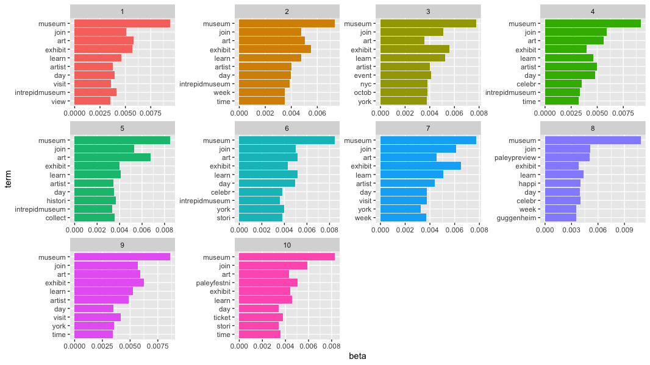
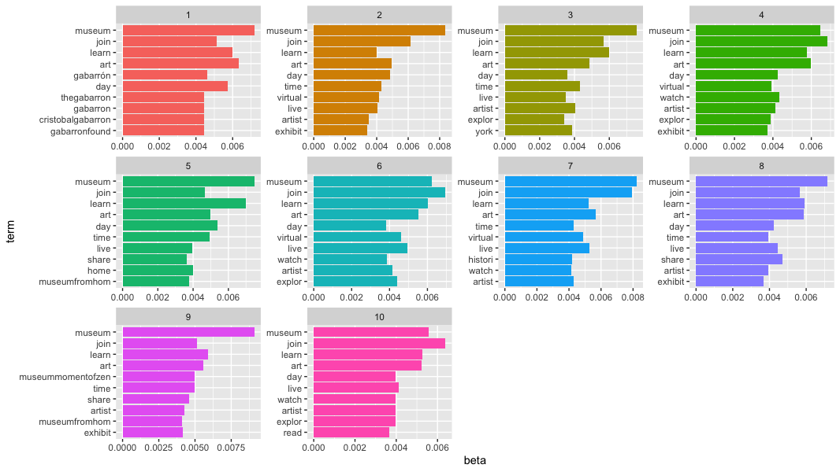
Pre-COVID
vs.
Post-COVID
Topic Modeling
Notes:
Topic modeling analyzed the top 10 groups of words among all the tweet text. The results are similar to word frequency. The organizations explored online approach to provide their services after COVID outbreak.

Slide 9
Descriptive Analysis
Notes:
Now, let’s take a look at the quantitative descriptive analysis results

Slide 10
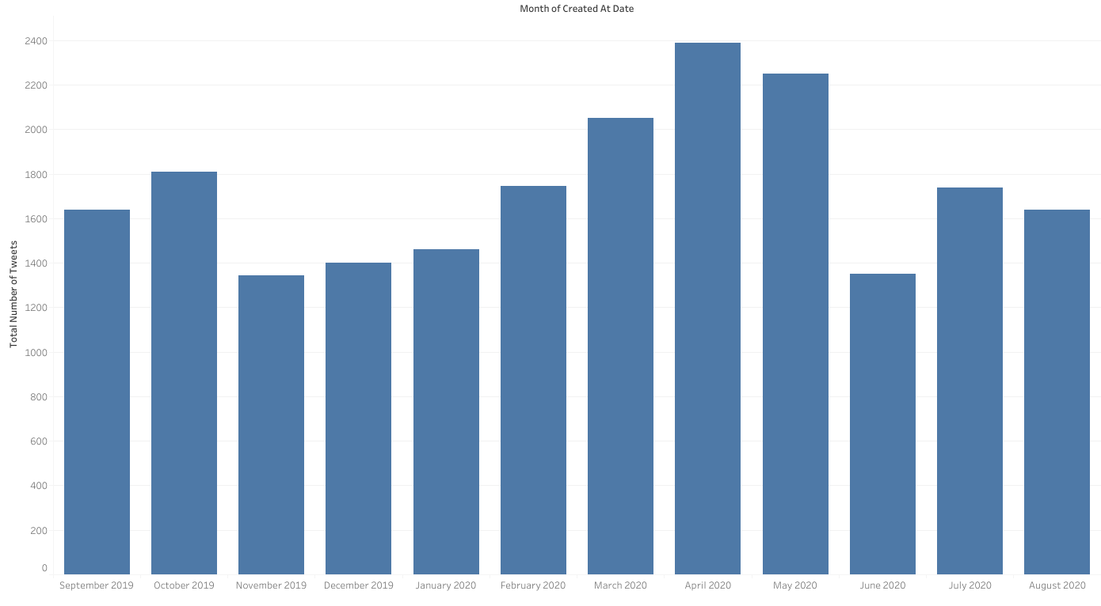
Total number of tweets by month
Notes:
https://public.tableau.com/profile/hanjin.mao#!/vizhome/COVID_ArtNPO/No_tweet_bymonth?publish=yes
The total number of tweets posted by art and culture nonprofits in NYC increase after the COVID-19 outbreak. March, April and May are the peak months.

Slide 11
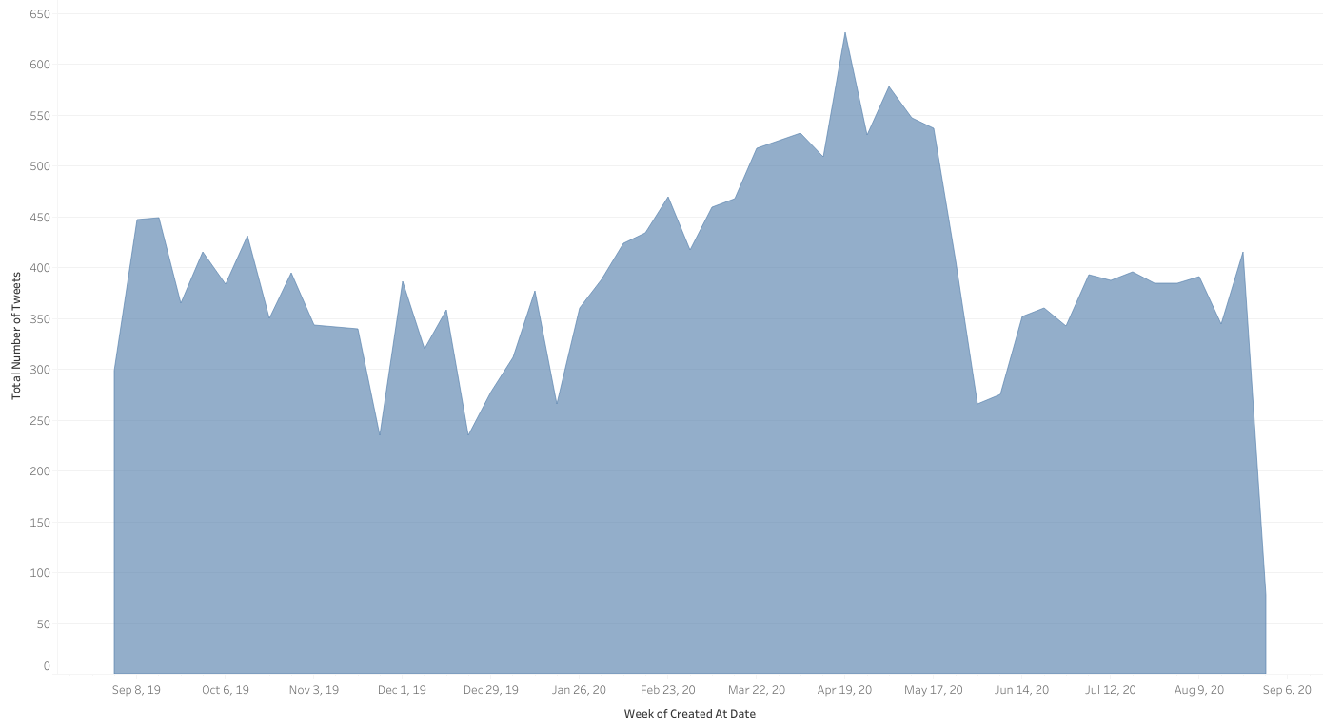
Mid-April
March 1st
May 31st
Total number of tweets by week
Notes:
If we take a look at the total number of tweets by week, we can see that the increase starts on March 1st, when the first COVID case was confirmed in NYC. It reached the peak in mid-April, when NY state recorded more COVID19 cases than any other country in the world. The activities on twitter cooled down in late may, when Governor Cuomo allowed low-risk activities to reopen gradually.

Slide 12
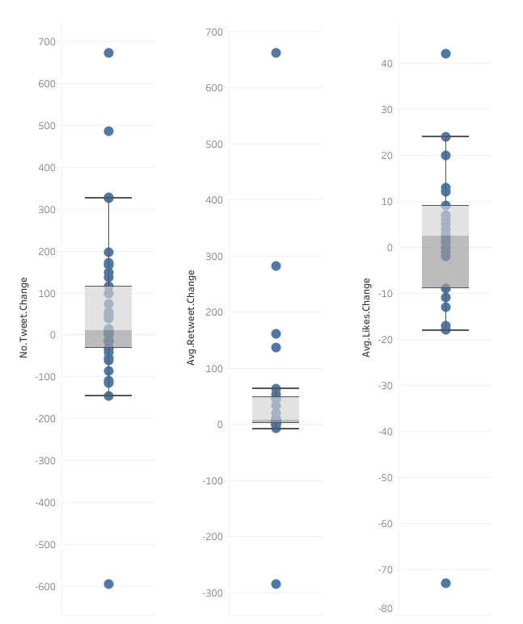
Post COVID change by organization
4 organizations opened or reactivated their Twitter accounts after COVID
27/41 (65.9%) organizations increased their number of tweets after COVID (median = 10)
24/41 (58.5%) organizations received a higher number of avg. retweets after COVID (median = 8)
19/41 (46.3%) organizations received a higher number of avg. likes after COVID (median = 2.5)
Notes:
https://public.tableau.com/views/COVID_ArtNPO/Dashboard1?:language=en&:display_count=y&:origin=viz_share_link
Here are some descriptive findings about the organizations we sampled. Generally speaking, both the organizations and their audience are more active on Twitter after COVID pandemic.
4 organizations opened or reactivated their Twitter accounts after COVID
27 organizations tweet more frequently after COVID. The median number of increase is 10.
24 of the organizations received a higher number of avg. retweets after COVID (The median number of increase is 8)
19 of them received a higher number of avg. likes after COVID (The median number of increase is 2.5)

Slide 13
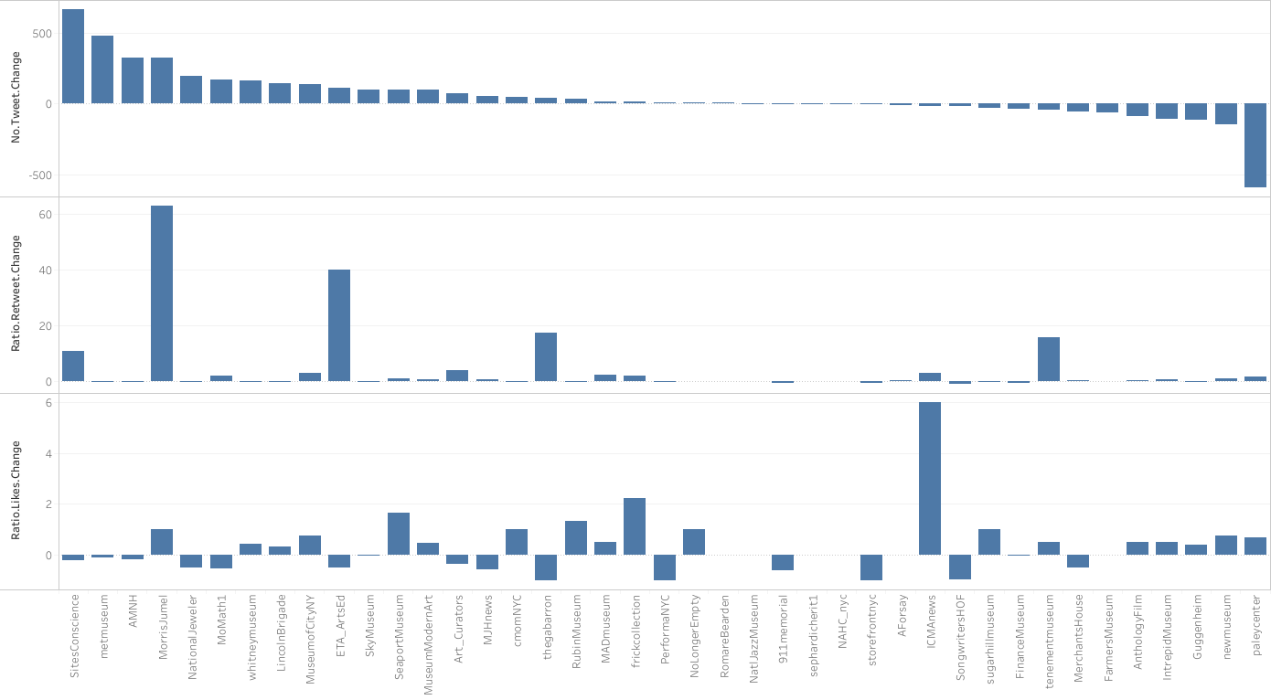
Post COVID change by Twitter account
Notes:
This bar chart shows the change in tweet frequency, and average number of retweet & likes of each organizational account.
The frequency change is measured by the total number of tweet 6 month post covid minus the total number of tweet 6 month pre covid.
The ratio of retweet change is measured by the average number of retweets of each tweet during post covid time minus the average number of retweets of each tweet during pre covid time divided by the pre covid average retweet number.
Similar with the ratio of like change. Measured by the increased ratio post covid vs. pre covid.
From the visualization, we can tell that the frequency of tweeting by the organization are somewhat positively correlated with the retweet they received. However, likes does not significantly correlate with tweeting frequency.

Slide 14
Regression Analysis
Notes:
Then, we did a regression analysis to test the observed correlation between tweeting frequency and the retweets and likes received.

Slide 15
 | Model 1 Ratio of Retweets Change | Model 2 Ratio. of Likes Change
(Intercept) | 10.609* | 0.646
Change of Tweets Amount | 5.391*** (0.555) | -0.014 (0.118)
No. of Followers (log) | -1.255** (0.447) | -0.021 (0.098)
No. of Friends (k) | 2.274** (0.743) | -0.034 (0.157)
R2 | 0.7832 | 0.0045
N | 35 | 35
Note: a. *** p<0.001; ** p<0.01; *p<0.05 b. Six of the forty-one sample organizations receive 0 average retweets pre-COVID. They are dropped from the regression analysis.
Notes:
The dependent variables in the two OLS model are the ratio of retweets change and the ratio of likes change. The key independent variable is the change of tweets frequency. We include number of followers and number of friends as the control variable.
The results show that the increase in tweeting frequency post-COVID positively correlated with the change in retweets. 1 percent increase in tweet frequency brings in more than 5% of increase in retweets. However, the change in tweeting frequency does not significantly influence the change of likes.

Slide 16
Conclusion
The art and culture nonprofits explore the online approach on social media to deliver their programs after the COVID outbreak.
The art nonprofits are more active on Twitter after the COVID outbreak.
The increased input on social media will increase the engagement of their audience.
Future study
Notes:
To sum up the answers to the research questions,
the art and culture nonprofits explore the online approach on social media to deliver their programs after the COVID outbreak.
The COVID-19 pandemic drives them to be more active on Twitter, specifically, increasing their tweeting frequency during the COVID-19 lockdown.
The organizations’ increased input on social media leads to an increase in the engagement of their audience.
Though the sample of this study focuses on arts and culture nonprofits in a limited geographic area, the findings can be a good reference for nonprofit organizations all around the changing world facing the ongoing pandemic.
The preliminary study opens a door to a lot of future research opportunities. In general, what is happening behind the screen? And how COVID-19 reshape the communication between nonprofit organizations and their stakeholders?
For example,
We find that tweeting frequency impacts retweets, but not likes, then why? what are the differences between likes and retweets? What are the mechanisms behind nonprofit stakeholders’ behavior and reaction on Twitter?
We investigated the impact of COVID 6 month after the outbreak, what are the longer-term impacts of COVID?
We take the art and culture nonprofits’ perspective, how does COVID impact other types of nonprofit organizations?
Finding answers to these questions will bring a thorough understanding of the nonprofit organizations’ active and passive responses to external crises like COVID-19, and also the changing dynamics in the nonprofit and voluntary sector of the post COVID-19 era.
That’s all for our presentation. We welcome any feedbacks. Thank you!

Slide 17
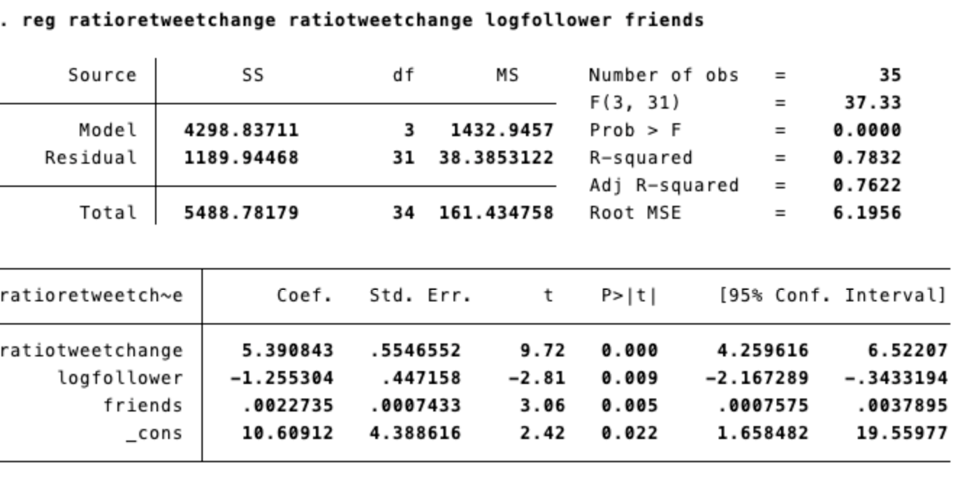

Slide 18
