Slide 1
Do Donors Care about Nonprofits’ Revenue Sources?
A Conjoint Experiment on the Impact of Revenue Source Information on Individual Giving
Hanjin Mao
School of Public Affairs and Administration
Rutgers University-Newark
ARNOVA Conference
San Diego, CA
Nov. 21st, 2019

Slide 2
Background
Individual giving is a major revenue source for nonprofits
Nonprofit organizations disclose all kinds of information to the public to attract donors
Accounting information is an important part of it
Existing studies find that the availability of accounting information has a positive impact on individual donations

Slide 3
Background
Previous studies on accounting information availability are focused on the expenditure side
=> How about the revenue side?
Accounting Information
Interaction between different revenue sources: the classic crowding-in and crowding-out model
Limitation: assume that donors possess perfect information about the organizations
=> Do donors really care about nonprofits’ revenue sources?
Expenditure
Revenue

Slide 4
Research Questions
Q1 Are donors influenced by the availability of revenue source information of nonprofit organizations?
Accounting Information
Expenditure
Revenue

Slide 5
Research Questions
Q1 Are donors influenced by the availability of revenue source information of nonprofit organizations?
Charitable Donations
Government Grants
Q2 How do existing revenue sources-
charitable donations
government grants
program service income
- impact individual giving decisions?
Q3 Does revenue diversification of nonprofit organizations influence individual giving?
Program Service Income
Other Revenue
Notes:
Charitable Donation:Private donations from individual donors.
Government Grant:Financial awards given by the federal, state, or local government to an eligible grantee.
Program Service Income:Income earned by selling products or service related to the mission of the organization.

Slide 6
Theory and Hypothesis 1
Q1 Are donors influenced by the availability of revenue source information of nonprofit organizations?
The availability of accounting information will positively influence donation decisions.
Program expenditure ratio
Favorable expenditure information
(Khumawala & Gordon, 1997; Parsons, 2003; Buchheit & Parsons, 2006; Parsons, 2007)
Accessible financial information is a sign of good governance
(Harris, Petrovits & Yetman, 2014)
Notes:
For Q1, existing studies find that the availability of accounting information has a positive impact on individual donations (Parsons, 2003). Accessible financial information is one of the factors that capture good governance (Harris, Petrovits & Yetman, 2014). Donors take financial information, especially the program expenditure ratio, and favorable information, as a useful part of the donation process (Khumawala & Gordon, 1997; Buchheit & Parsons, 2006; Parsons, 2007). However, these studies focused mostly on expenditure and ignored the revenue information. Following the same mechanism, the study hypothesizes: H1 - the availability of information on revenue sources of nonprofit organizations will have a positive effect on the donor’s giving decision.

Slide 7
H1
The availability of information on revenue sources of nonprofit organizations will have a positive effect on the donor’s giving decision.

Slide 8
Theory and Hypothesis 2
Q2 How do existing revenue sources-charitable donations, government grants, program service income- impact individual giving decisions?
A mixed impact of other revenue sources on individual donation
Crowding-in model
More revenue shows better competency
Donors are encouraged by the good performance of nonprofit organizations
(Galbiati & Vertova, 2008; Galbiatia & Vertova, 2014; Lu, 2015; Rose-Ackerman, 1986; Brooks, 1999; Okten & Weisbrod, 2000; Posnett & Sandler, 1989)
Notes:
For Q2, the theoretical foundation of the interaction between different revenue sources lies in the mechanisms (Bekkers & Wiepking, 2010) that drives charitable giving. On one side, donors are altruistic. They care about the need for support, the cost and benefit, and the efficacy of every dollar they spend. In this way, other revenue sources crowd out private contributions. On the other side, the ability to gain income from other resources proves a better competency and trustworthiness of the organization. As a result, other income sources attract donors in favor of better-performance nonprofits (Lu, 2015; Rose-Ackerman, 1986; Brooks, 1999; Okten & Weisbrod, 2000; Posnett & Sandler, 1989). Another argument is Andreoni’s (1989) model of impure altruism. As donors are also motivated by a “warm glow”, the magnitude of the crowding-out or crowding-in effect of other revenue sources is not significant. A rich body of empirical studies has tested the crowding-in and crowding-out effect of government funding and program service revenue. For government funding, some studies were in support of the crowding-out hypothesis(Andreoni, 1993; Bolton & Katok, 1998; Sutter & Weck-Hannemann, 2004; Eckel et al., 2005; Reeson & Tisdell, 2008; Konow, 2010; Korenok et al., 2012; Isaac & Norton, 2013; Kim & Van Ryzin, 2014; Ottoni-Wilhelm et al., 2017), while others proved the existence of the crowding-in effect (Galbiati & Vertova, 2008; Galbiatia & Vertova, 2014). Some other studies find neither crowding-in or crowding-out effects are significant (Blanco et al., 2012; Wasif & Prakash, 2017). For program service revenue, some studies confirmed its positive correlation with the charitable donation directly and indirectly(Okten & Weisbrod, 2000; Trussel & Parsons, 2007). Other studies find no significant crowd-out effect (Mardas & Jacobs, 2004). Based on these studies, H2 - Individual donation, government funding, and program service income will have a positive or negative effect on the donor’s giving decision.

Slide 9
Theory and Hypothesis 2
Crowding-out model
Donors are altruistic
More revenue from other sources lower the need for additional individual contribution
(Andreoni, 1993; Bolton & Katok, 1998; Sutter & Weck-Hannemann, 2004; Eckel et al., 2005; Reeson & Tisdell, 2008; Konow, 2010; Korenok et al., 2012; Isaac & Norton, 2013; Kim & Van Ryzin, 2014; Ottoni-Wilhelm et al., 2017; Okten & Weisbrod, 2000; Trussel & Parsons, 2007)
Neither Crowding-in nor Crowding-out
Donors are motivated by a “warm glow” - they don’t care
(Andreoni 1989; Mardas & Jacobs, 2004; Blanco et al., 2012; Wasif & Prakash, 2017)
Notes:
For Q2, the theoretical foundation of the interaction between different revenue sources lies in the mechanisms (Bekkers & Wiepking, 2010) that drives charitable giving. On one side, donors are altruistic. They care about the need for support, the cost and benefit, and the efficacy of every dollar they spend. In this way, other revenue sources crowd out private contributions. On the other side, the ability to gain income from other resources proves a better competency and trustworthiness of the organization. As a result, other income sources attract donors in favor of better-performance nonprofits (Lu, 2015; Rose-Ackerman, 1986; Brooks, 1999; Okten & Weisbrod, 2000; Posnett & Sandler, 1989). Another argument is Andreoni’s (1989) model of impure altruism. As donors are also motivated by a “warm glow”, the magnitude of the crowding-out or crowding-in effect of other revenue sources is not significant. A rich body of empirical studies has tested the crowding-in and crowding-out effect of government funding and program service revenue. For government funding, some studies were in support of the crowding-out hypothesis(Andreoni, 1993; Bolton & Katok, 1998; Sutter & Weck-Hannemann, 2004; Eckel et al., 2005; Reeson & Tisdell, 2008; Konow, 2010; Korenok et al., 2012; Isaac & Norton, 2013; Kim & Van Ryzin, 2014; Ottoni-Wilhelm et al., 2017), while others proved the existence of the crowding-in effect (Galbiati & Vertova, 2008; Galbiatia & Vertova, 2014). Some other studies find neither crowding-in or crowding-out effects are significant (Blanco et al., 2012; Wasif & Prakash, 2017). For program service revenue, some studies confirmed its positive correlation with the charitable donation directly and indirectly(Okten & Weisbrod, 2000; Trussel & Parsons, 2007). Other studies find no significant crowd-out effect (Mardas & Jacobs, 2004). Based on these studies, H2 - Individual donation, government funding, and program service income will have a positive or negative effect on the donor’s giving decision.

Slide 10
H2
Individual donations, government grants, and program service income will have a positive or negative effect on the donor’s giving decision.

Slide 11
Theory and Hypothesis 3
Q3 Does revenue diversification of nonprofit organizations encourage individual giving?
Revenue concentration is a signal of financial vulnerability
Greater financial stability brings in more charitable contributions
(Trussel & Parsons, 2007; Tuckman & Chang, 1991; Greenlee & Trussel, 2000; Parsons & Trussel, 2008)
Notes:
For Q3, revenue concentration is a significant predictor of financial vulnerability.
Existing literature shows that nonprofits with greater financial stability and higher revenue diversification generate more contributions (Trussel & Parsons, 2007; Tuckman & Chang, 1991; Greenlee &Trussel, 2000; Parsons & Trussel, 2008).
Therefore, H3 - Revenue diversification of nonprofit organizations will have a positive impact on the donor’s giving decision.

Slide 12
H3
Revenue diversification of nonprofit organizations will have a positive impact on the donor’s giving decision.

Slide 13
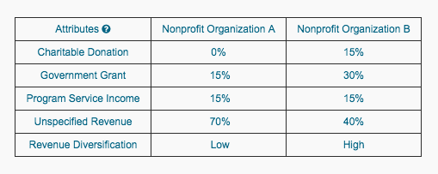
Conjoint Survey Experiment
Attributes
(Various parameters to make decisions)
Profile A
Profile B
Profile C
Randomized Levels
No Information
0%
15%
30%
No Information
0%
15%
30%
Levels
(Various options available per attribute)
Notes:
Conjoint survey experiment is widely used in marketing research. Identify the relative importance of different attributes and influences of different levels on consumers. Let’s look at the example in business world first.
See charitable donation as a purchase of a product of a nonprofit organization
Mimic a donation decision process
Determine how people value different attributes that make up a nonprofit organization
Using an experimental methodology, the study mimics a donation decision process in a controlled environment to investigate the causal relationship between the information on revenue sources of nonprofit organizations and the donation decision. The conjoint design will ask respondents to first evaluate three pairs of nonprofit organizations that combine multiple attributes side-by-side and then make donation decisions. The availability of revenue information, the proportion of revenue sources (charitable donation, government funding, program service income), level of revenue diversification are manipulated.
Charitable Donation:
Private donations from individual donors.
Government Grant:
Financial awards given by the federal, state, or local government to an eligible grantee.
Program Service Income:
Income earned by selling products or service related to the mission of the organization.
Unspecified Revenue:
Revenue from other unspecified resources.
Revenue Diversification:
The extent of revenue dispersion. The greater number of revenue stream, the higher diversification

Slide 14
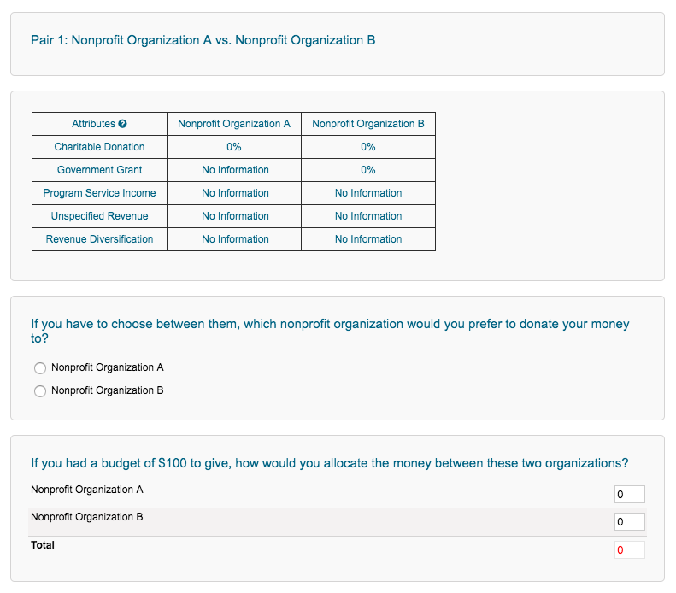
Survey
Sample
Each respondent answers
3 conjoint tables

Slide 15
Data Analysis
The survey was distributed on Qualtrics
An online sample of US adults (with nationally representative quotas by region, gender, age, and race-ethnicity)
840 responses
Final observations: (840-38) Responses * 3 conjoint tables * 2 organizations = 4,812
Average Marginal Component Effect (AMCE)
AMCE represents the marginal effect of a particular attribute while averaging over the remaining attributes in the regression model

Slide 16
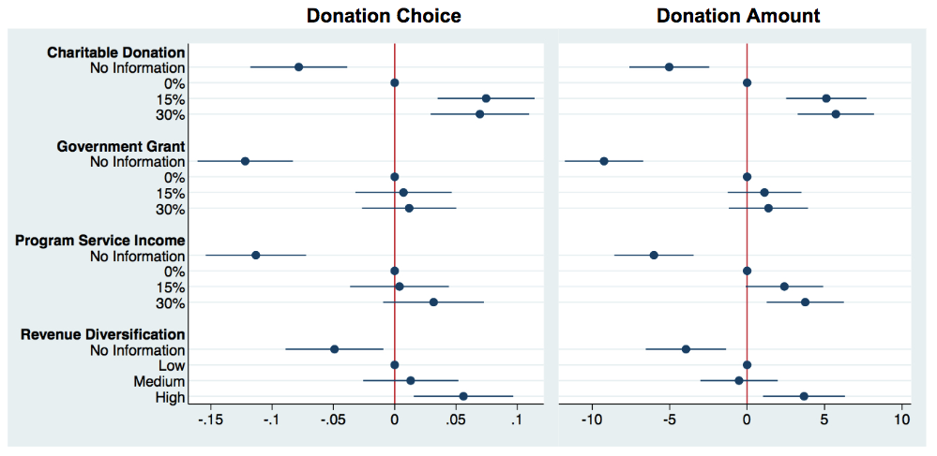
Result
Notes:
Dependent Variable and Independent variable
Base level
Example of AMCE:

Slide 17
H1 The availability of information on revenue sources of nonprofit organizations will have a positive effect on the donor’s giving decision.
Accepted: Donors prefer available revenue source information.

Slide 18
H2 Charitable donations, government grants, and program service revenue will have a positive or negative effect on the donor’s giving decision.
Partially accepted: Revenue from charitable donations crowd-in new giving.

Slide 19
H3 Revenue diversification of nonprofit organizations will have a positive impact on the donor’s giving decision.
Partially accepted: Only when revenue diversification is high.

Slide 20
Implementation
To attract donors and donations for nonprofits
Make revenue source information available - zero is better than unknown
Let donors know other people give
Diversify revenue sources

Slide 21
Thank you
Hanjin Mao
hanjin.mao@rutgers.edu

Slide 22
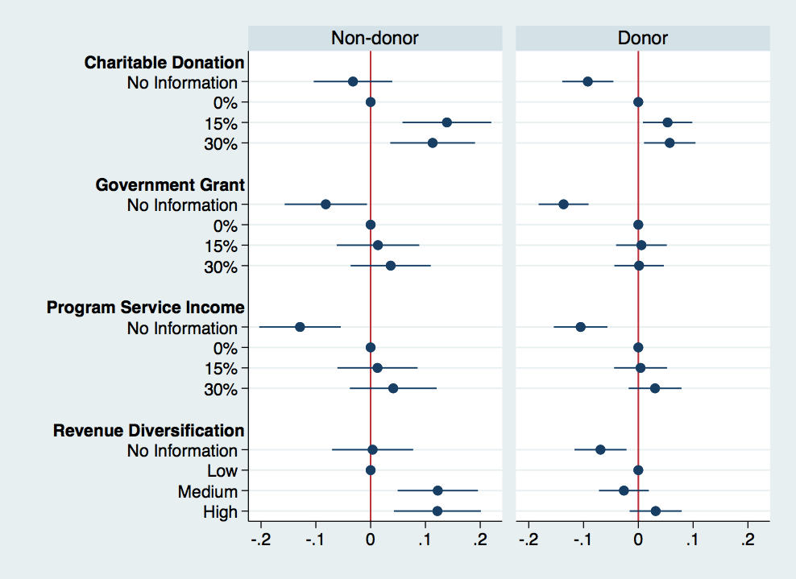
Donation Choice of Subgroups: Donor vs. Non-donor
Donors care more

Slide 23
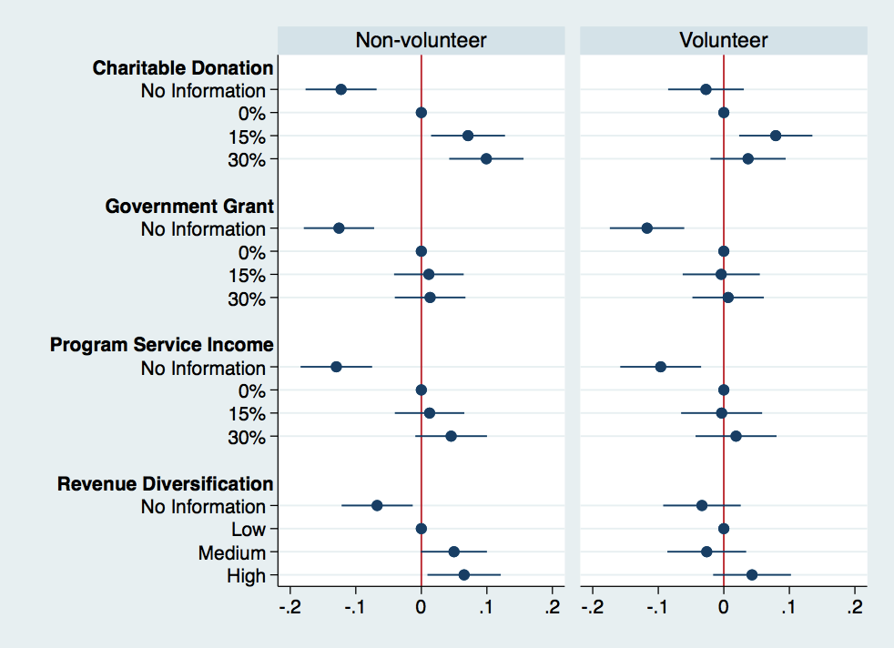
Donation Choice of Subgroups: Volunteer vs Non-volunteer
Non-volunteers care more

