Slide 1
Text Mining for Systematic Review in Public Administration
Hanjin Mao - Rutgers University - Newark
Huafang Li - Grand Valley State University
NECOPA 2020

Slide 2
Background
Barriers of Systematic Literature Review: Manual and labor intensive (Carver et al., 2013)
Text mining for systematic literature review in other disciplines, such as computer engineering, biology, and medicine (Ananiadou et al., 2009; Felizardo et al., 2011; Feng et al., 2017; Korhonen et al., 2012)
Benefits of Text Mining: Objective, transparent, efficient (Walker et al., 2019)
Notes:
Systematic literature reviews summarize the progress of studies and pave roads for future research in an academic field. It may serve as the foundation for new research or as a way to summarize an existing body of literature. Systematic reviews are a common method in public administration (Hansen & Tummers, 2020; Kim et al., 2019a, 2019b; Li, 2020). However, conducting a systematic literature review can be burdensome and time-consuming. There are some common barriers of systematic literature review. The process is largely manual and thus very labor intensive. A lot of labor is spent from identifying relevant paper, to paper reading and analysis.
To overcome the barriers of systematic literature review, especially in data extraction and analysis process, computer-assisted methods like text mining techniques have been used to facilitate the process (Li & Van Ryzin, 2017). There are emerging research applying text mining method in systematic literature review in other disciplines, such as computer engineering, biology and medicine. These studies find that text mining is a powerful tool for systematic reviews.
In the public administration field, text mining is an emerging method. Scholars argue that text mining is a more objective, transparent, and efficient analysis of textual data, offering ample opportunities to produce insights for the study and practice of public administration (Walker et al., 2019).
However, it is still a very new method for researchers in public administration, especially for the purpose of reviewing literature.

Slide 3
Research Questions
Is text mining an effective tool for reviewing literature in the field of public administration?
If so, how can public administration researchers use text mining methods to improve systematic reviews?
Notes:
In this study, we try to answer the following research questions: Is text mining an effective tool for reviewing literature in the field of public administration? If so, how can public administration researchers use text mining methods to improve systematic reviews?

Slide 4
Data and method
Case Study
Chinese Public Administration Review (CPAR)
126 articles
2002 to 2019
Text Mining
Clustering
Topic Modeling
Automatic Multi-terms Extraction
Text Network
Machine results vs. Human coded results (Lu et al., 2019)
Notes:
To answer these questions, we conduct a case study using a unique dataset of all articles published in the Chinese Public Administration Review (CPAR). CPAR is a peer-reviewed international journal addressing the issues of Chinese, Asian, and international public administration. It is an emerging journal in public administration. The publications comes from diverse geographic context, by diverse scholars, and in diverse themes.
We apply text mining techniques, in particular, clustering and topic modeling, automatic muli-terms extraction, text network to systematically review the 126 publications in CPAR from 2002 to 2019.
We then compare our findings with human coded results (Lu et al., 2019) to test the effectiveness of text mining for systematic literature reviews in public administration.
R package (dplyr)(tidytext) (topicmodels)(cluster)(textnet)

Slide 5
Results
Clustering
Topic Modeling
Term Extraction
Text Network

Slide 6
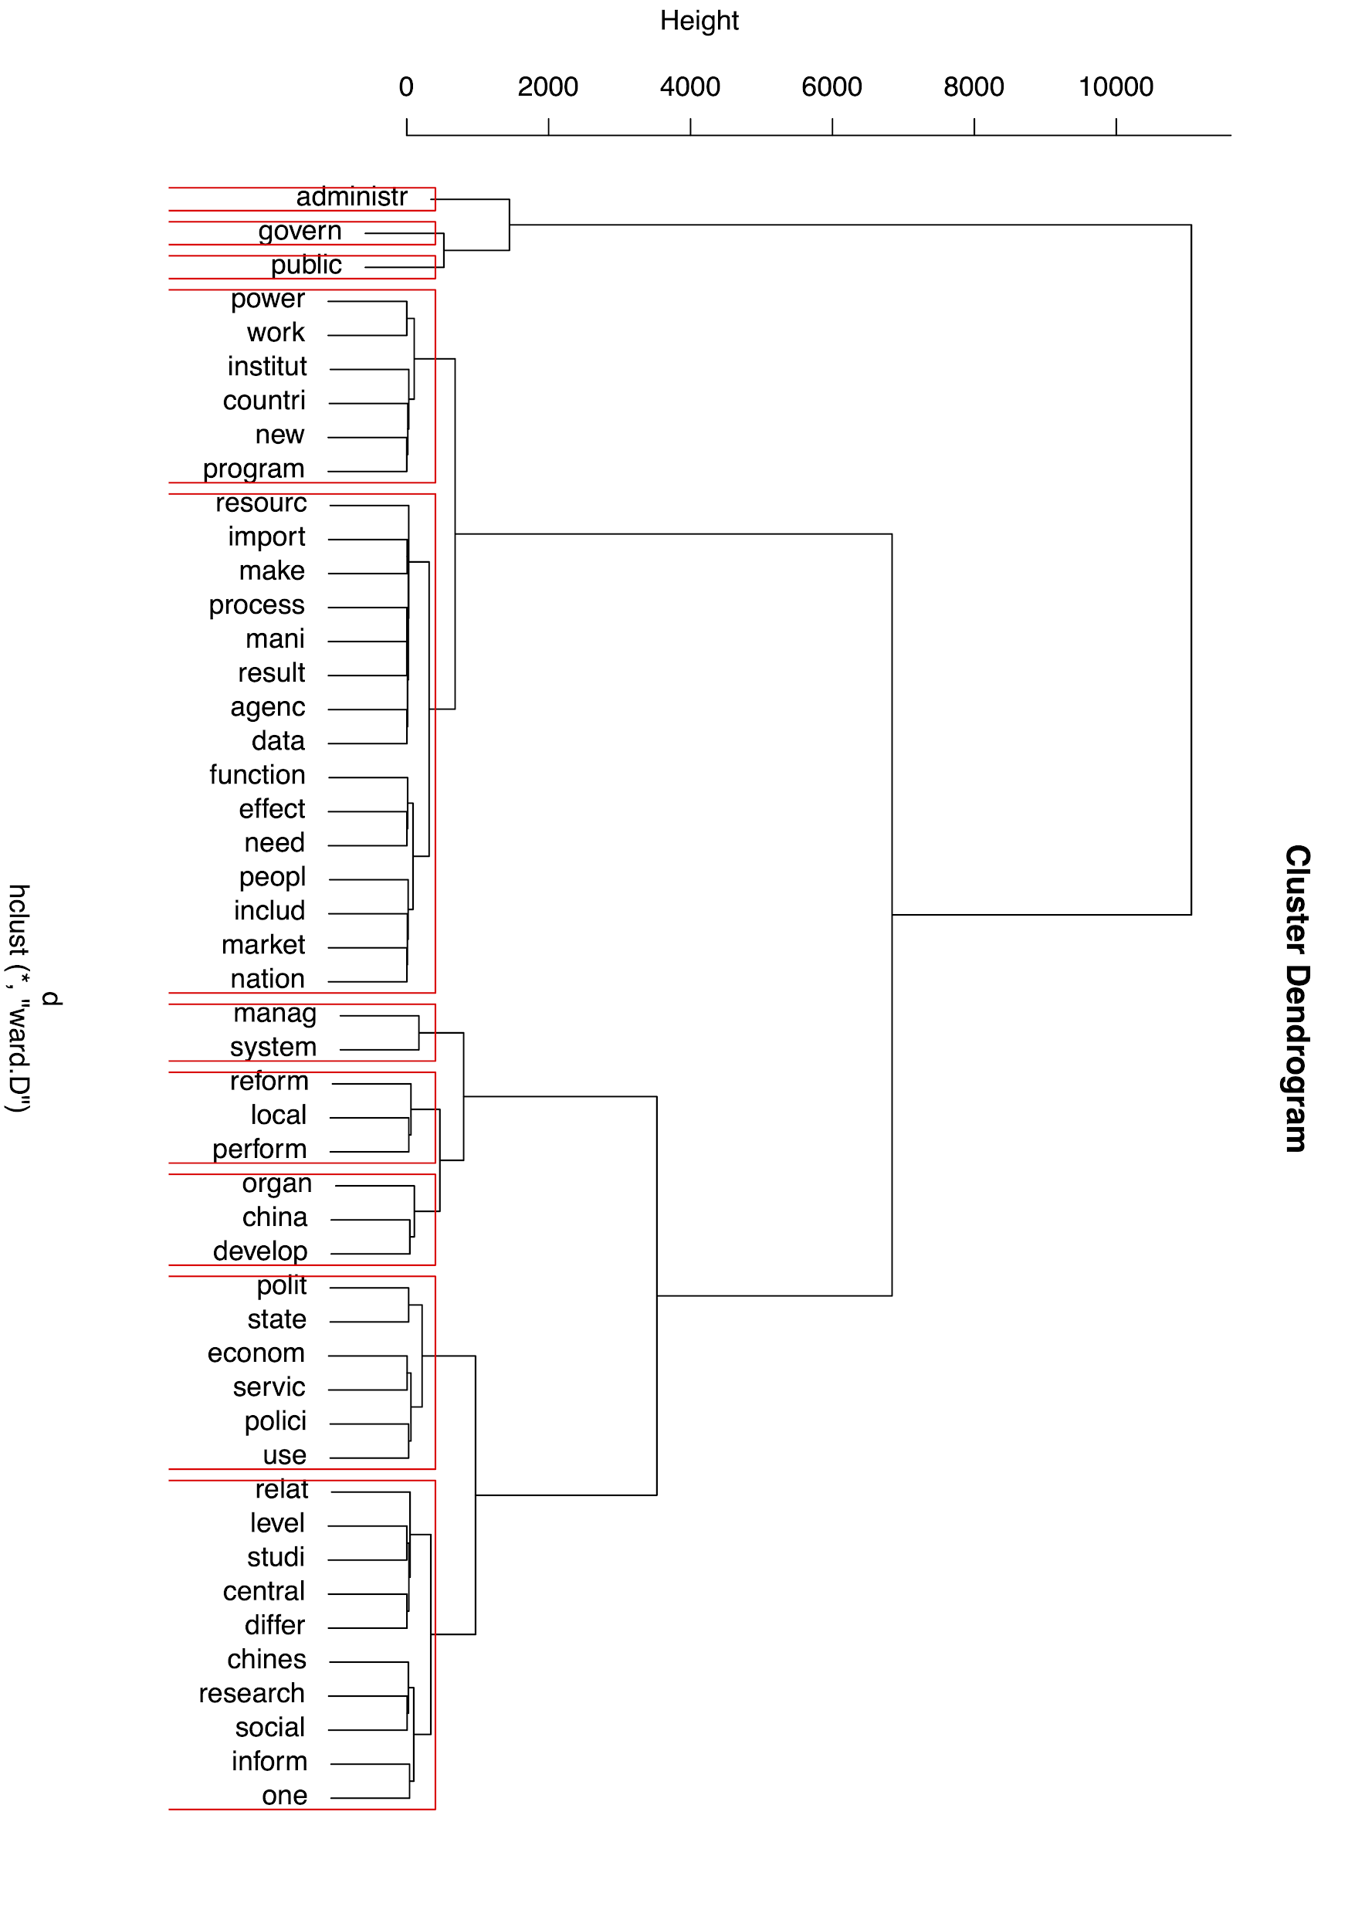
Clustering
Human Coded Themes | Identified by cluster analysis
Performance Management | ✓ perform
Administrative Reform | ✓ reform
Public Policy | ✓ polici
Human Resources Management
Public Administration Education
Institutional Relationship | ✓ insitut
Intellectual History
E-Governance
Nonprofit Management
Innovation and Entrepreneurship
Public Finance
Comparative Administration
Collaboration
Civil Service
Citizen Participation
Trust and Transparency
Public-Private Interaction
Administrative Law
Notes:
a hierarchical cluster analysis, It shows which of these words tend to appear together in the full text.
This analysis focus on only the most frequent words to appear in the full text.

Slide 7
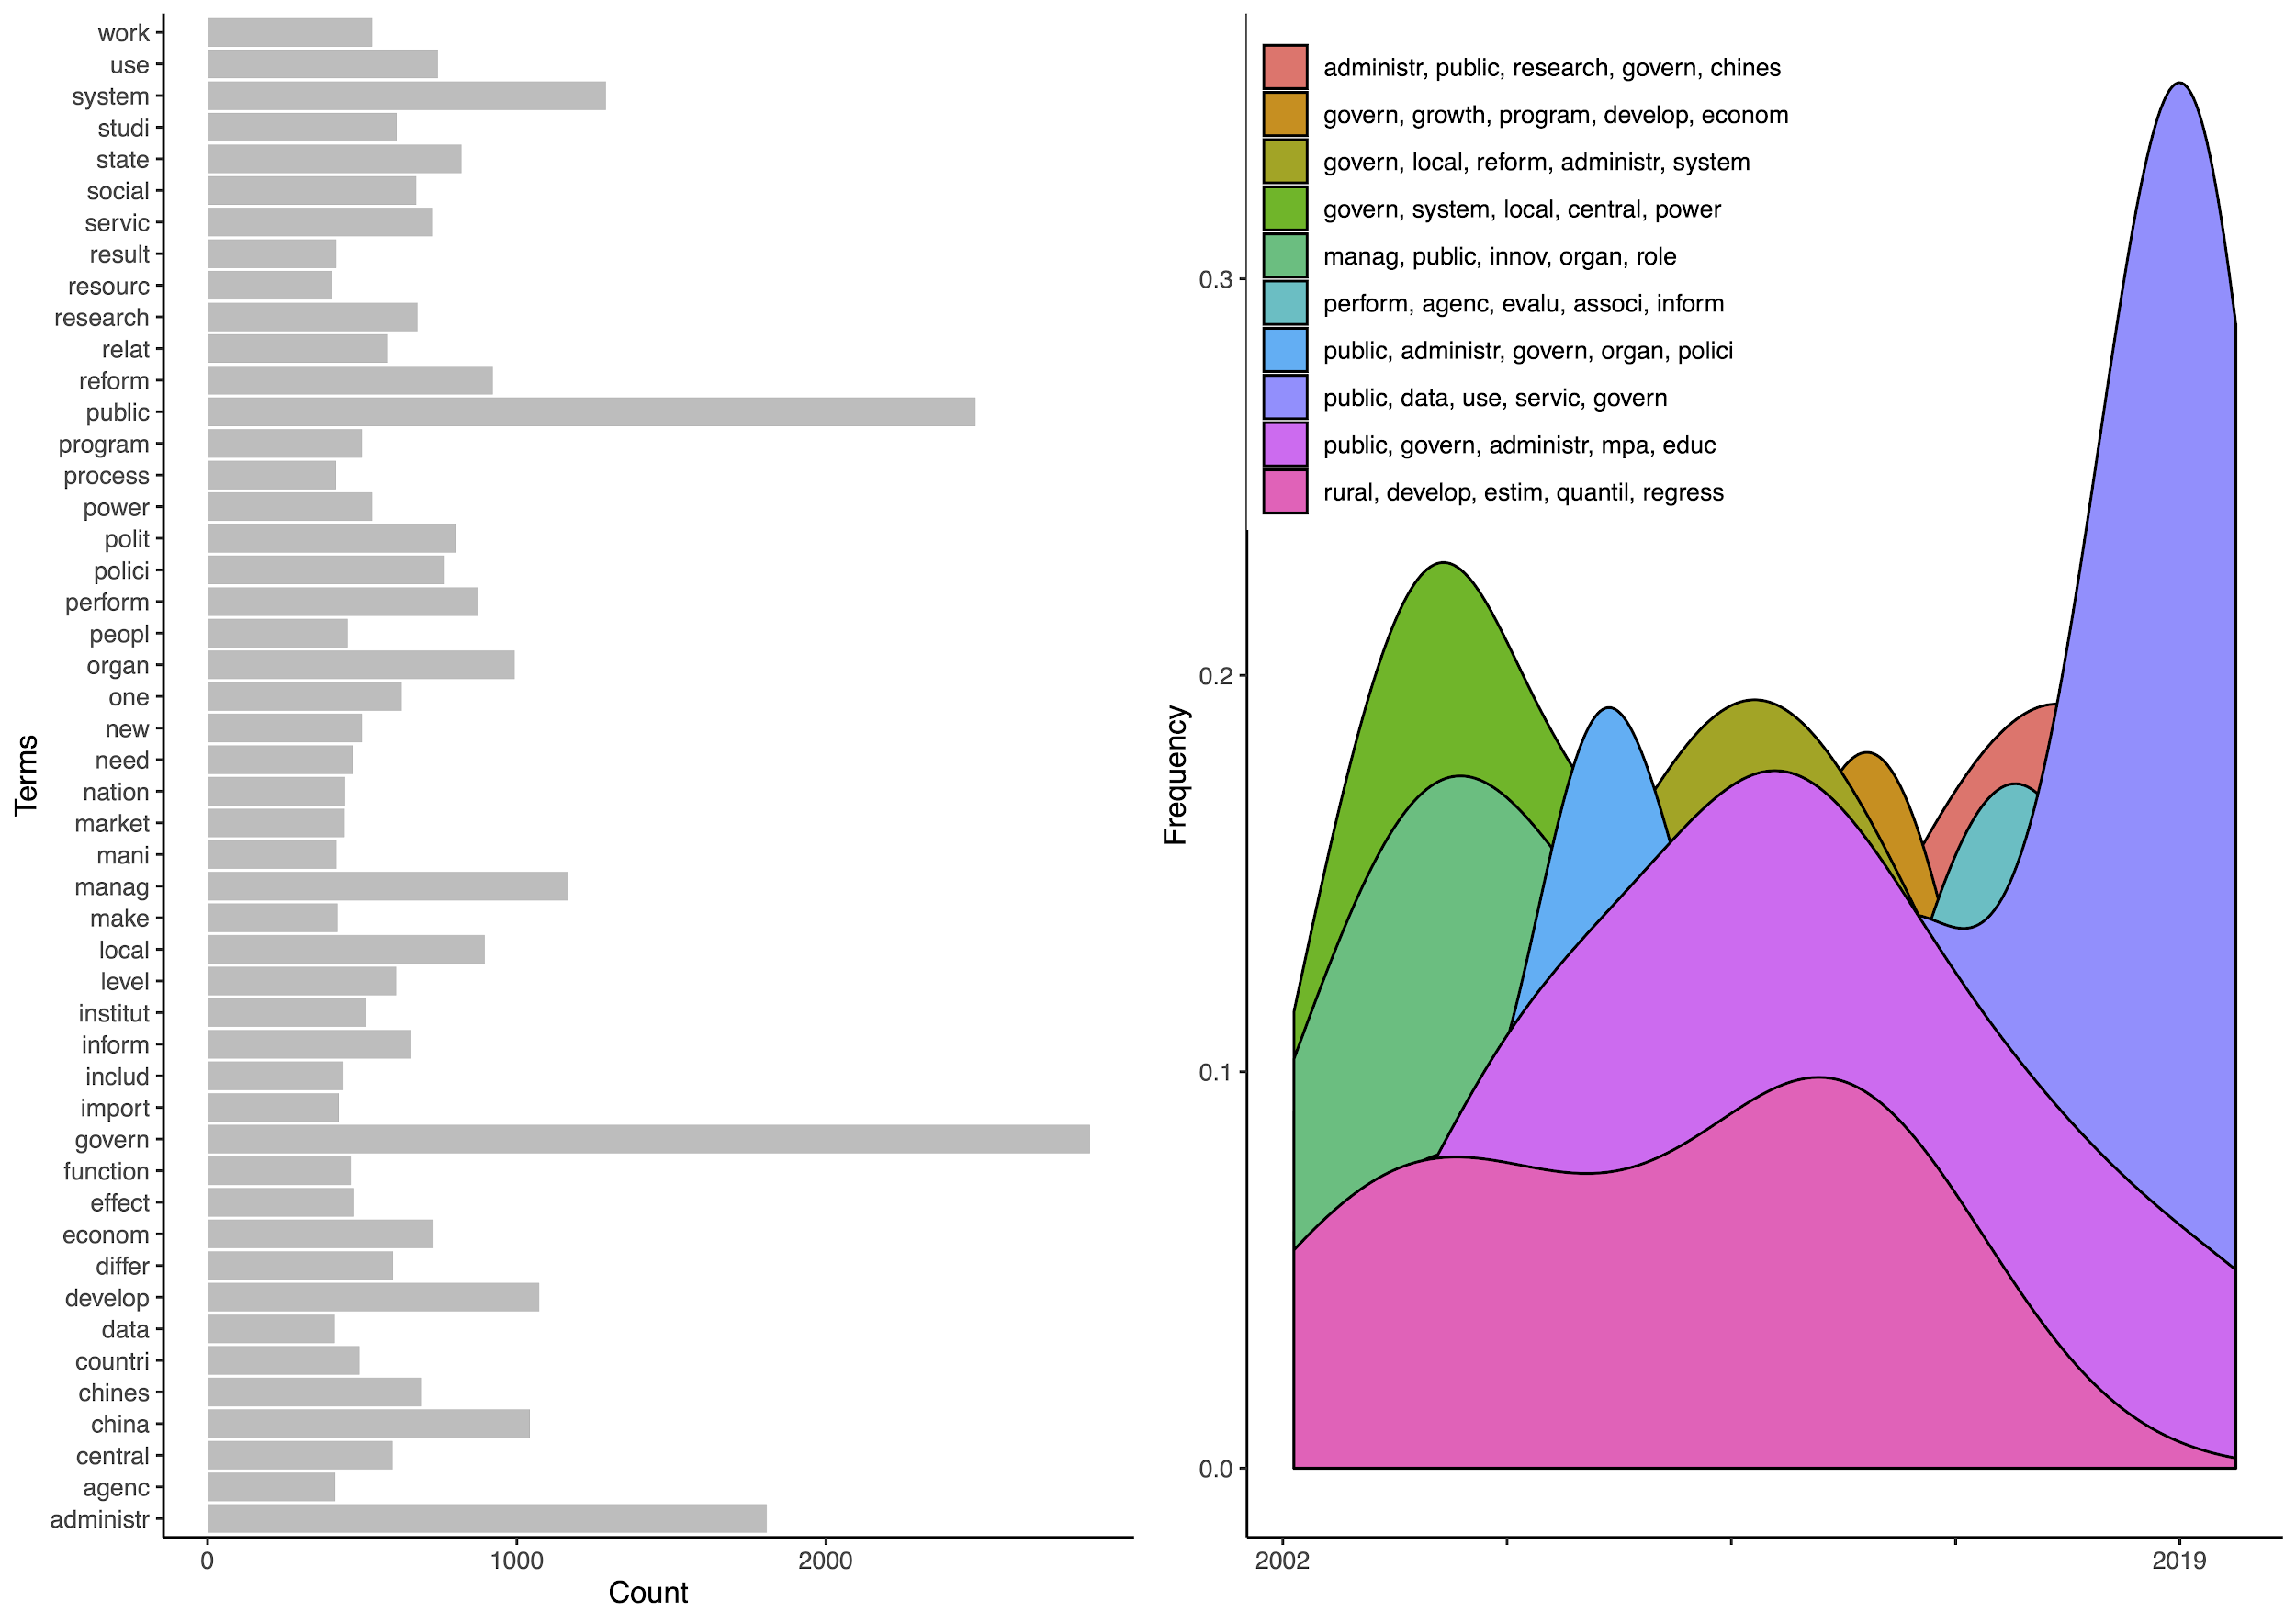
Topic
Modeling
Notes:
Topic modeling is an unsupervised machine learning technique that's capable of scanning a set of documents, detecting word and phrase patterns within them, and automatically clustering word groups and similar expressions that best characterize a set of documents.
Topics are unstructured and consist of ranked lists of terms, whose weights are associated with their likelihood of being used when a topic is drawn.
One major limitation is that the topics they identify are not in themselves easy to interpret, and consequently not substantively “trustworthy.”
Results are not 100% replicable

Slide 8
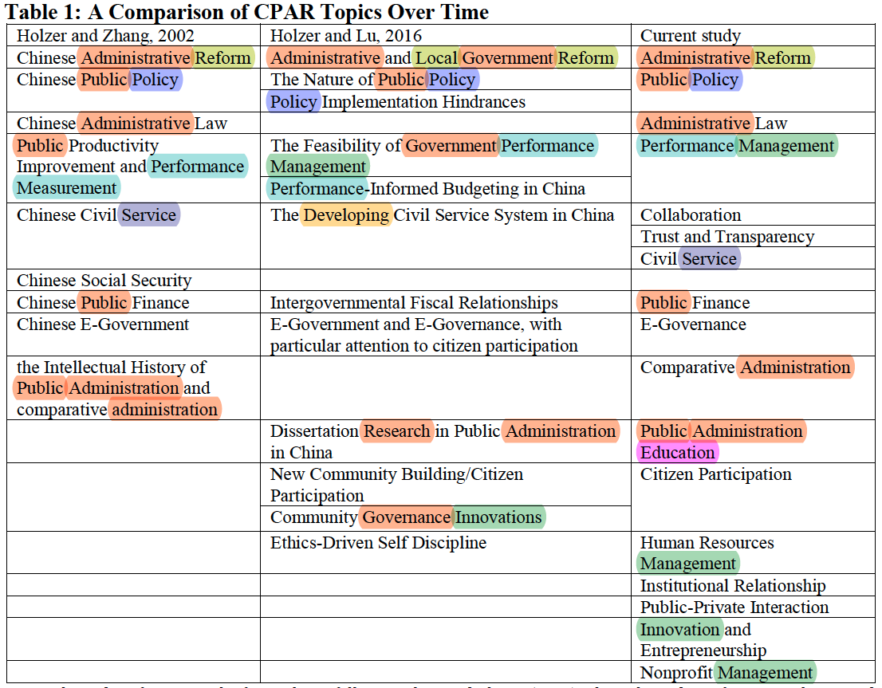

Slide 9
Term
Extraction
main form | forms | frequency | # of documents
public administration | public administration|&|public administrators|&|public administrations | 284 | 42
public managers | public managers|&|public management|&|public manager | 115 | 27
public sector | public sector|&|public sectors | 73 | 26
market economy | market economy|&|economy market | 62 | 24
public policy | public policy|&|public policies | 118 | 23
administrative system | administrative system|&|administration system|&|administrative systems|&|system of the administration | 45 | 22
administrative reform | administrative reform|&|administrative reforms|&|administration reform|&|administration reforms|&|reform the administration|&|administrative reformers | 58 | 19
State Council | state council | 54 | 18
Public Affairs | public affairs | 30 | 18
economic reform | economic reform|&|economic reforms | 26 | 17
political science | political science|&|political sciences | 31 | 16
government performance | government performance|&|performance of government|&|performance government|&|performance in government | 39 | 16
social science | social science|&|social sciences | 23 | 15
public servants | public servants|&|public servant | 31 | 15
other countries | other countries | 31 | 15
Republic of China | republic of china | 25 | 15
government reform | government reform|&|government reforms|&|governance reforms|&|reform government|&|reform of government | 41 | 15
government functions | government functions|&|function of the government|&|functions of government|&|function of government|&|government function|&|functions of the government | 34 | 15
Notes:
The extraction process proceeded in four steps:
1. a part-of-speech tagger was run over the full corpus. A Part-Of-Speech Tagger (POS Tagger) is a piece of software that reads text in some language and assigns parts of speech to each word (and other token), such as noun, verb, adjective, etc.
2. A text chunking algorithm was then used to identify noun phrases corresponding to a predefined set of grammatical sequences (e.g., a sequence made of list of adjectives preceding at least one noun, such as administrative system; economic reform; political science).
3. Extracted multiterms were then gathered under the same class when their stemmed version was identical (“manager” “managers” and “management” are then indexed under the same class).
Similarly, semantically coherent multiterms like “administrative reform,” “administration reform,” “reform the administration,” “administrative reformers,” and so on, are gathered into the same class.
4. We index different terms classes and denote their frequency.
From this list, we then select the set of the 2,000 most frequent multiterm
A top list based on number of distinct documents

Slide 10
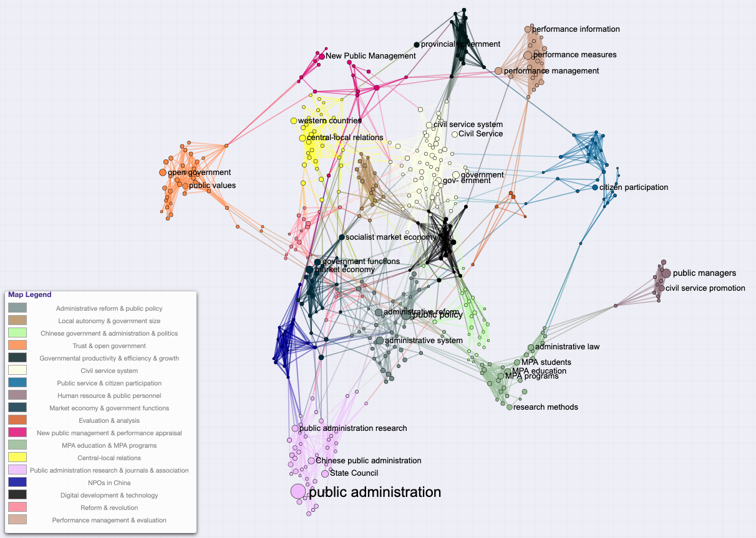
Text
Network
Notes:
Text network mapping based on the top 2000 terms extracted from full text
Node size scales with frequency of terms’ occurrence.
Nodes are colored according to the connected component or community to which they belong.

Slide 11
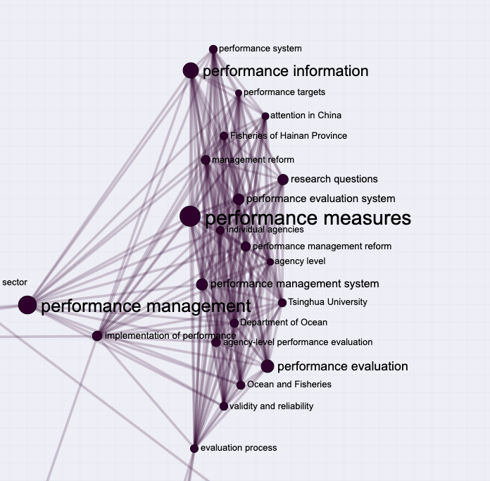
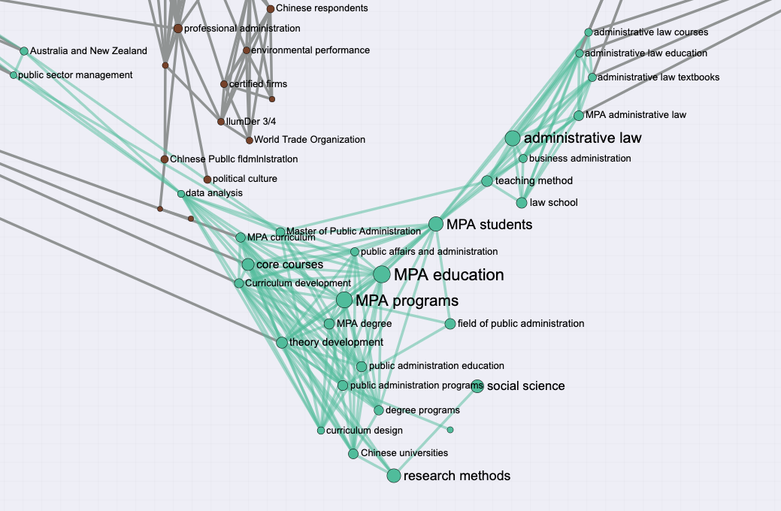

Slide 12
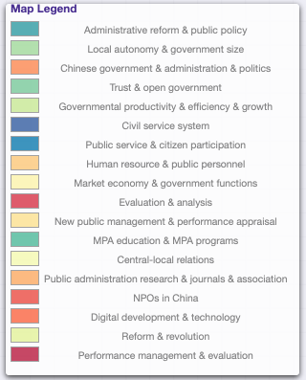
Human Coded Themes | Number of Articles | Identified by text network
Performance Management | 31 | ✓
Administrative Reform | 21 | ✓
Public Policy | 11 | ✓
Human Resources Management | 11 | ✓
Public Administration Education | 10 | ✓
Institutional Relationship | 9 | ✓
Intellectual History | 7 | ✓
E-Governance | 7 | ✓
Nonprofit Management | 6 | ✓
Innovation and Entrepreneurship | 6
Public Finance | 4
Comparative Administration | 4 | ✓
Collaboration | 4
Civil Service | 3 | ✓
Citizen Participation | 3 | ✓
Trust and Transparency | 3 | ✓
Public-Private Interaction | 3
Administrative Law | 2

Slide 13
Conclusion
Text mining is an effective tool reviewing literature in the field of public administration
Researchers can apply text mining methods to assist with systematic literature review, especially the data extraction and analysis process.
More efficiently
More systematically
More objectively
Visualization
Future potential
Searching and screening
Document classification

