Slide 1
The Effects of Information Technology Adoption and Expenses on Donor Behavior
Hanjin Mao
Rutgers University - Newark
ARNOVA 2021
Nov. 20th, 2021

Slide 2
Background
Information technology adoption in nonprofits
Dissertation: The Financial Returns of Information Technology Adoption in Nonprofit Organizations
Positive impact of IT expenditure on total donations with 990 data
Why? From donor’s perspective
Literature in organizational performance and overhead costs
Notes:
Nonprofit organizations generally lag in adopting IT, compared to their counterparts in for-profit sector. One main reason is lack of funding sources, because IT is expensive to establish, maintain, and upgrade.
COVID-19 reshape the nonprofit sector and enlarge their challenges in post pandemic era. For example, fewer fundraising campaigns are taking place on the ground. Events are hold virtually, like the ARNOVA conference. Volunteer recruitment is difficult because social distancing. Internal communication is challenging with remote work. Community engagement is challenging with people stay at home.
Nonprofit managers are struggling with adopting many kinds of information technology. One major challenge is, it is hard to convince the donors or funders that IT investments worth it as it’s not easy to evaluate the output and outcome.
So, my dissertation investigate whether the IT expenditure can be paid off - the title is the financial returns of information technology adoption in nonprofit organizations.
In the first essay of my dissertation, I found positive impact of IT expenditure on total donations of nonprofit organizations with 990 data.
In practice, nonprofit managers generally believe that investment in information technology will bring benefits. But why? What’s the behavioral mechanism behind it? Donors as key stakeholders are one of the main factors that distinguish nonprofits from the private sector. So, I designed this study to investigate the IT payoff problem from the donor’s view.
Previous studies support that good organizational performance attracts donations. Nevertheless, no studies have looked at the level of IT adoption as part of the performance. Meanwhile, a rich body of literature has discussed the negative impact of overhead costs on donations. Studies also find overhead aversions change on different types of overhead. Among them, many are experimental studies. However, none of the studies have investigated the impact of information technology cost as part of the overhead expenses. Thus, the purpose of this study is to test the donor’s reaction to the organizations’ performance about information technology adoption and the expenses the organizations spend on it.

Slide 3
Research Questions
Do donors care about nonprofits’ performance in information technology adoption?
What are the effects of information technology expenses on donor behavior? Specifically,
How does the amount of information technology expense impact donor behavior?
How does the purpose of information technology expense impact donor behavior?

Slide 4
Hypotheses
H1: Performance in information technology adoption has a positive effect on donations
H2: IT expenses have a negative impact on donations
H3: Detailed information disclosure of IT expenditures purposes has a positive impact on donations

Slide 5
Methodology
Online survey experiment
Rutgers SPAA Omnibus Survey
Qualtrics
April 2021
One of the eight studies
N=1,040
National representative quotas
Notes:
A survey experiment is conducted online. The survey is distributed through Rutgers-Newark SPAA Omnibus program. It is an annual program sponsored by the Center for Experimental and Behavioral Public Administration (CEBPA) in my school.
In April 2021, the Omnibus ran a survey experiment on Qualtrics. This study is one of the eight studies in the Omnibus.
One thousand and forty responses with national representative quotas are received.
The sampling quotas by age, gender, race-ethnicity, and region were established for the survey based on the most recent estimates of the US population from the US Census Bureau, QuickFacts.

Slide 6
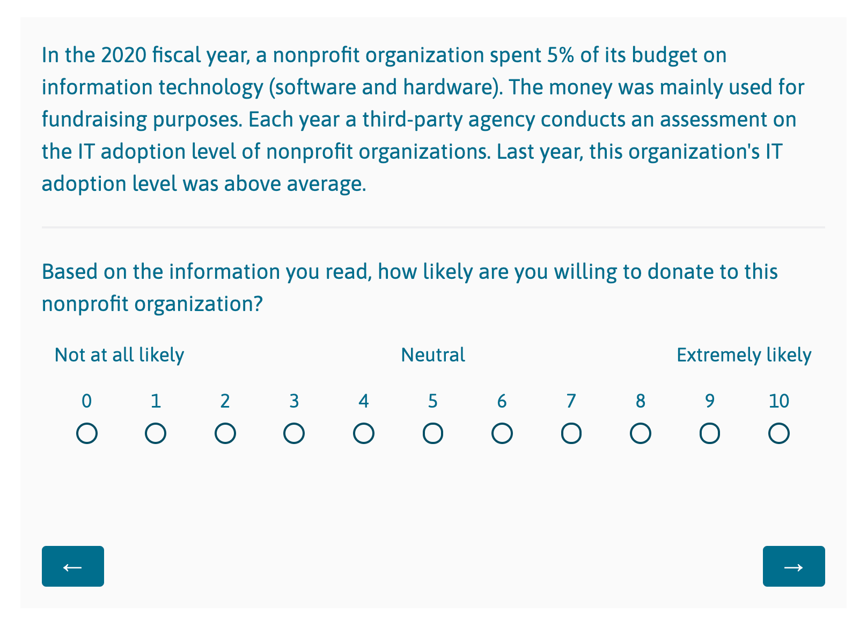
2 x 4 x 3 Factorial Design
Treatment 1: IT Expenses | <1% (baseline) 5%
Treatment 2: Purposes of IT Cost | No information (baseline) Management Fundraising Program Service
Treatment 3: IT Adoption Level | Below average Average (baseline) Above average
Notes:
The experiment used a 2 x 4 x 3 factorial design. The three attributes are the amount of IT expenses, the purposes of IT expenses, the level of IT adoption. In the expense amount, the two levels are less than 1% and 5% of the total expenses. The purposes of expenses are manipulated as no information (baseline), management purposes, fundraising purposes, program service purposes. The levels of IT adoption are average (baseline), below average, and above average.
First, one of the 24 vignettes includes a statement about a nonprofit organization’s IT adoption was randomly assigned to the participants. “In the 2020 fiscal year, a nonprofit organization spent [‘less than 1%’ / ‘5%’] of its budget on information technology (software and hardware). The IT budget was mainly spent for [no information / ‘fundraising purposes’ / ‘program service purposes’ / ‘management purposes’]. Each year, a third-party agency conducts an assessment on the IT adoption level of nonprofit organizations. Last year, this organization’s IT adoption level was [ ‘below average’ / ‘average’ / ‘above average’].” After reading the statement, the participants use a 0-10 scale to evaluate their likelihood of donation.

Slide 7
Analysis
Average Marginal Component Effect (ACME) Analysis
Dependent Variable: Donor’s willingness to donate (0-10)
Independent Variables:
Percentage of IT expenses (less than 1%; 5%)
The purpose of IT expenses (no information; managerial; fundraising; program service)
IT adoption level (below average; at average; above average)
Demographic Subgroups:
Gender; Age; Race-ethnicity; Education level; Income level; Employer sector; Volunteer status; Donor status
Notes:
I used the Average Marginal Component Effect Analysis to evaluate the impact of each randomized treatment on donations. AMCE represents the marginal effect of a particular attribute while averaging over the remaining attributes in the regression model. In this study, it measures the average causal effect of each attribute on donation behavior. The dependent variable is the donor's willingness to donate. The independent variables are the percentage of IT expenses, the purpose of IT expenses, and IT adoption level. I compared results within demographic groups based on gender, age, race-ethnicity, education level, income level, employer sector, volunteer status, donor status, to see the difference in the effects.

Slide 8
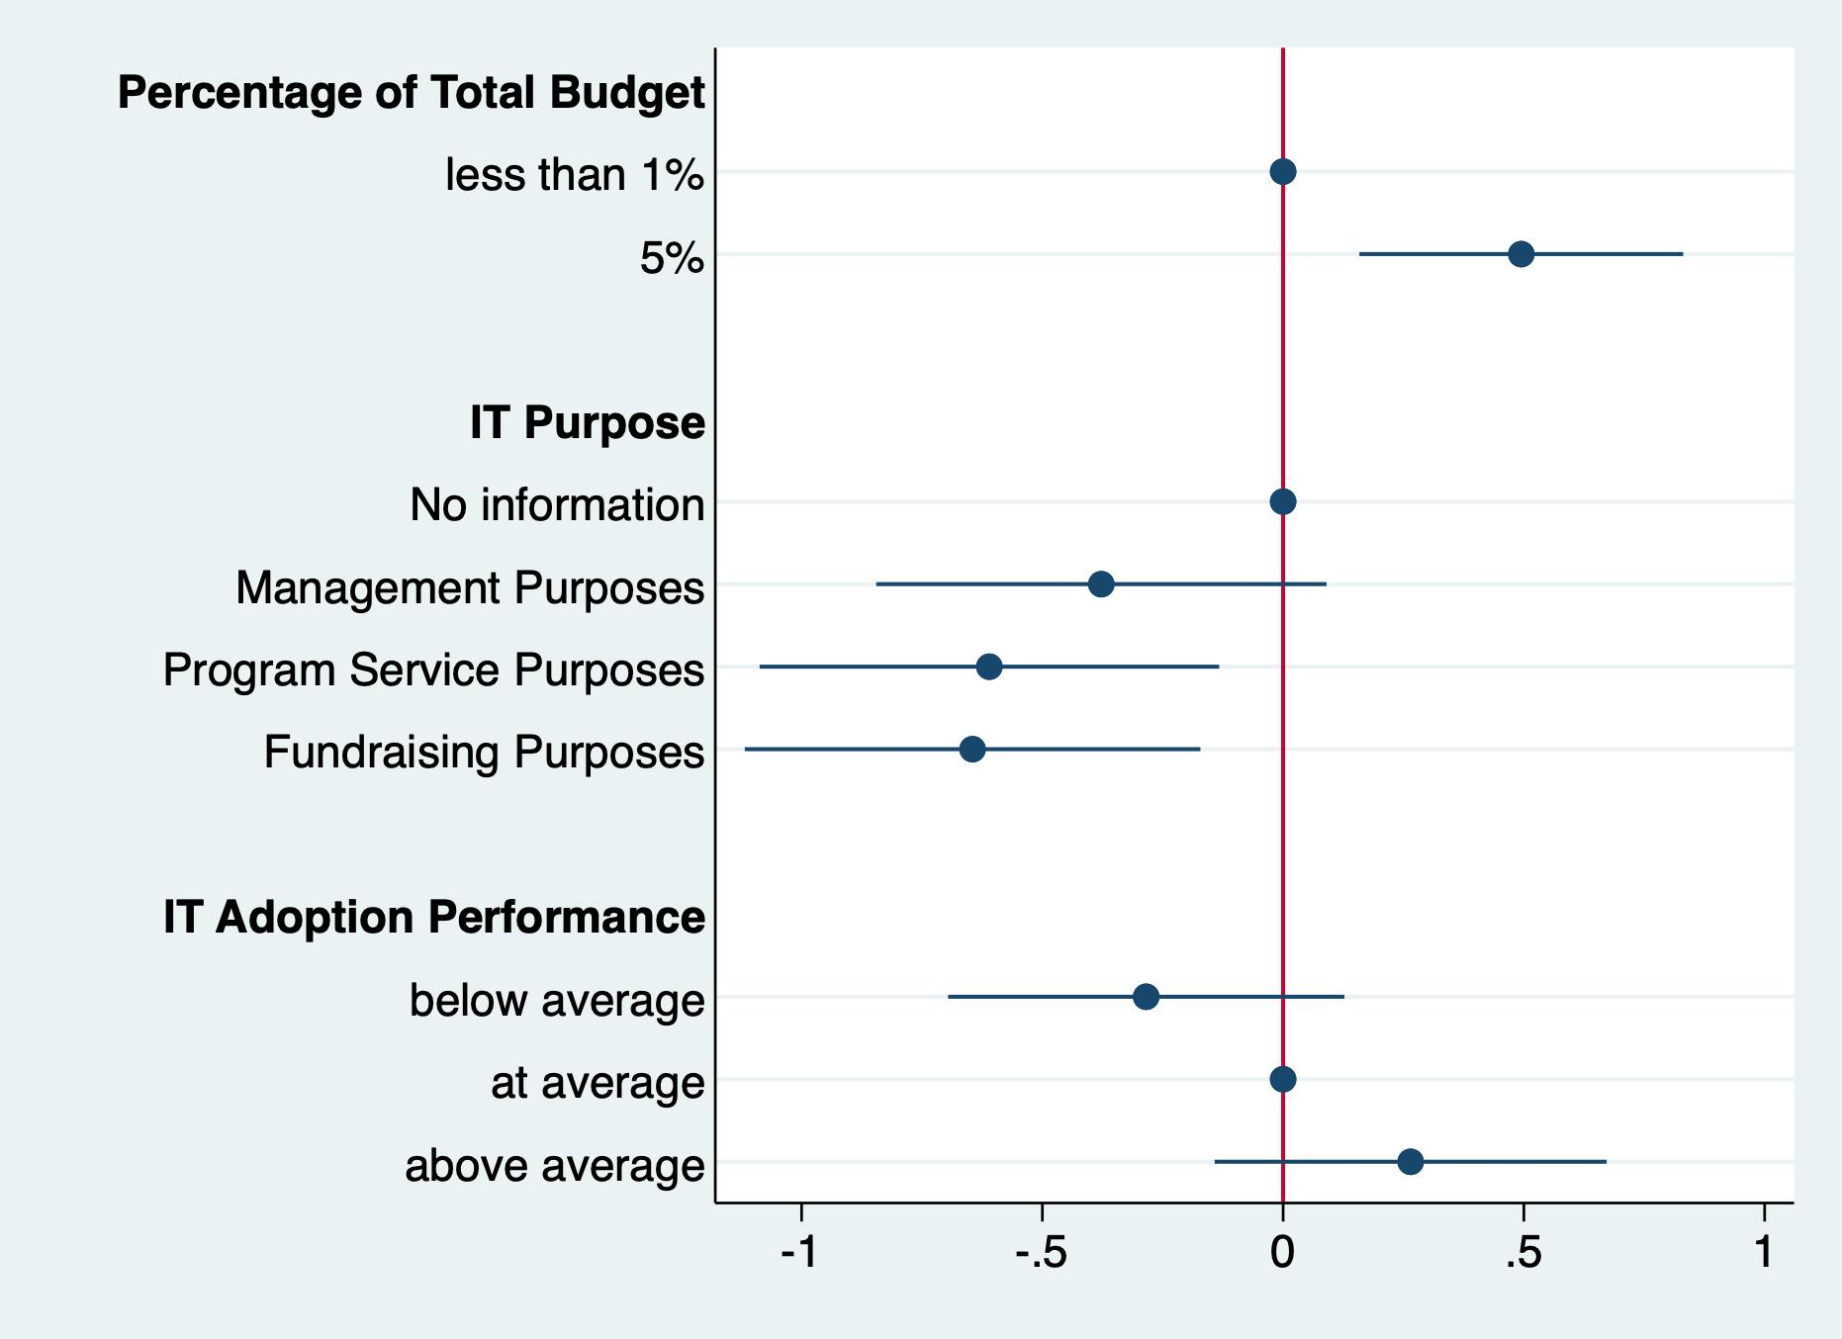
Findings
✅
H1: Performance in information technology adoption has a positively effect on donations
H2: IT expenses has a negative impact on donations
H3: Detailed information disclosure of IT expenditure purposes has a positive impact on donations
❎
❎
Notes:
Here is the results of the AMCE analysis.
The Percentage of Total Budget. When people see the organization spend 5% of its budget on IT, they are more likely to donate than those who see less than 1% of total budget spent on IT. This result rejected the second hypothesis, IT expenses does not have a negative impact on donations. Actually, within a reasonable range, the higher spending on IT, the more likely donors will donate.
The Purpose of IT projects. We thought donors are in favor of information disclosure about where the organization spend their IT budget on, because organizational transparency is welcomed. Surprisingly, no. This result rejected the third hypothesis. Detailed information disclosure of IT expenditure purposes has a negative impact on donations. Especially, donors do not like spending money on program service related IT projects and IT budget for fundraising purposes.
IT adoption performance. The result is not surprising. Performance in IT adoption has a positive impact on donations, though the result is not statistically significant.

Slide 9
Implications
Performance matters
Overhead aversion
Information disclosure
Notes:
The study confirms that performance matters for donations. The IT adoption level reveals part of the performance of the organizations and it positively impact donations.
Overhead aversion. Though previous literature suggests that higher proportion of overhead over decreases charitable donations. However, the amount of IT expenditures has a positive impact on donations. One implication is, IT cost is different from other overhead cost. It should not be seen as simple part of the cost on infrastructure. One potential explanation is, people may have expectations about adopting IT to save money on administration. IT spending should not be neglected in nonprofit literature.
Information disclosure and transparency is not always a good thing. In this study, donors care about the purpose of IT spending in nonprofits. Nonprofits need to be careful about how to communicate the right information with donors to receive their support on IT projects, or more broadly speaking, support management, fundraising, and program expenses.

Slide 10
Subgroup Comparison

Slide 11
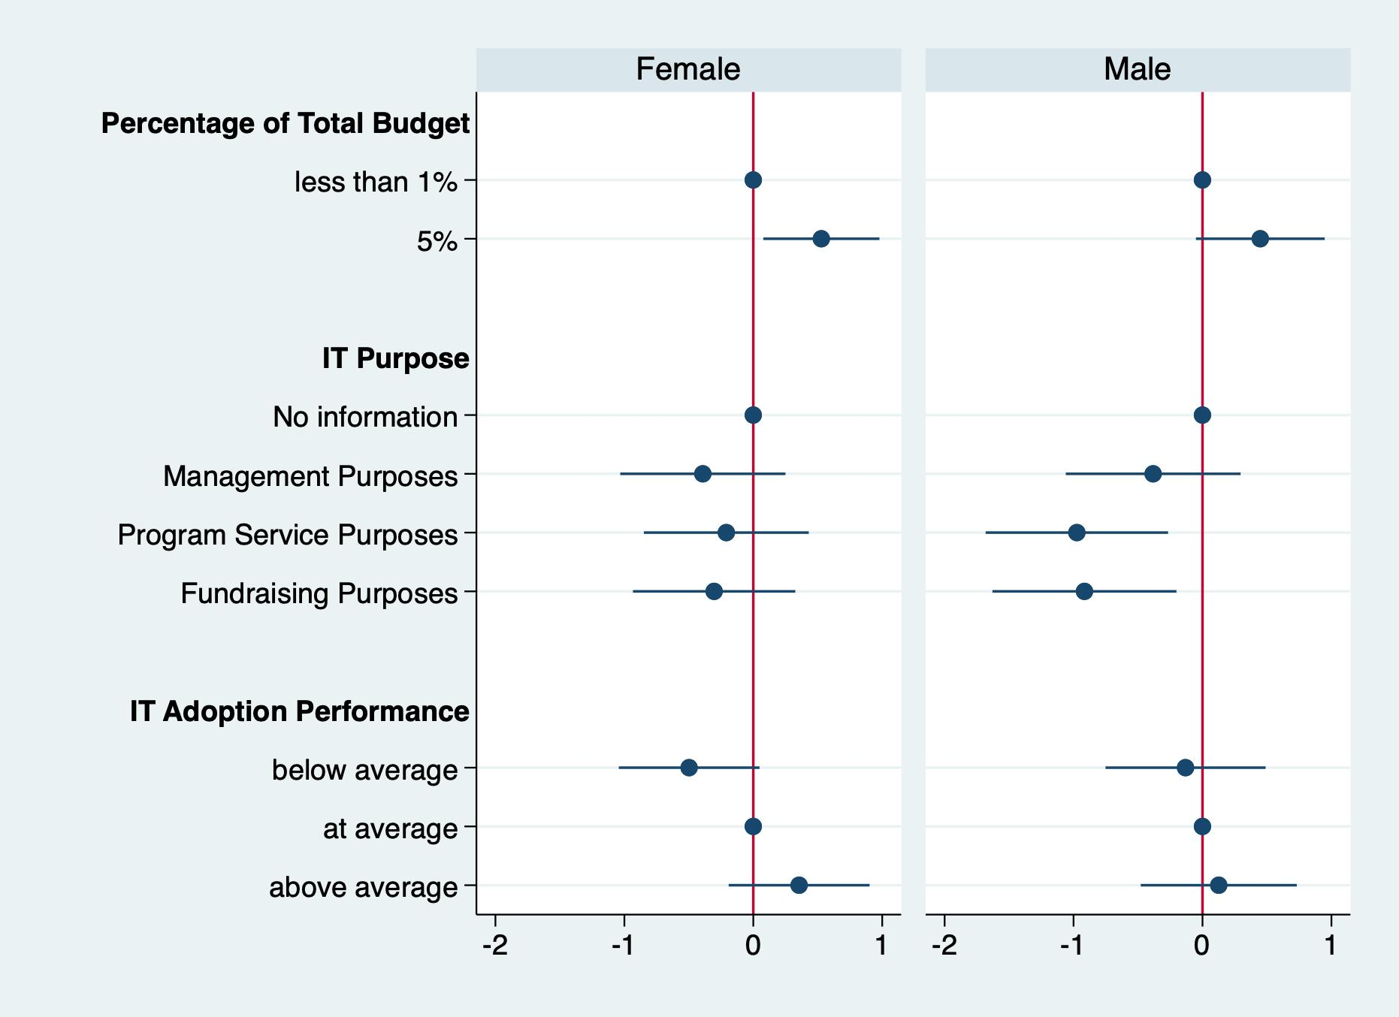

Slide 12
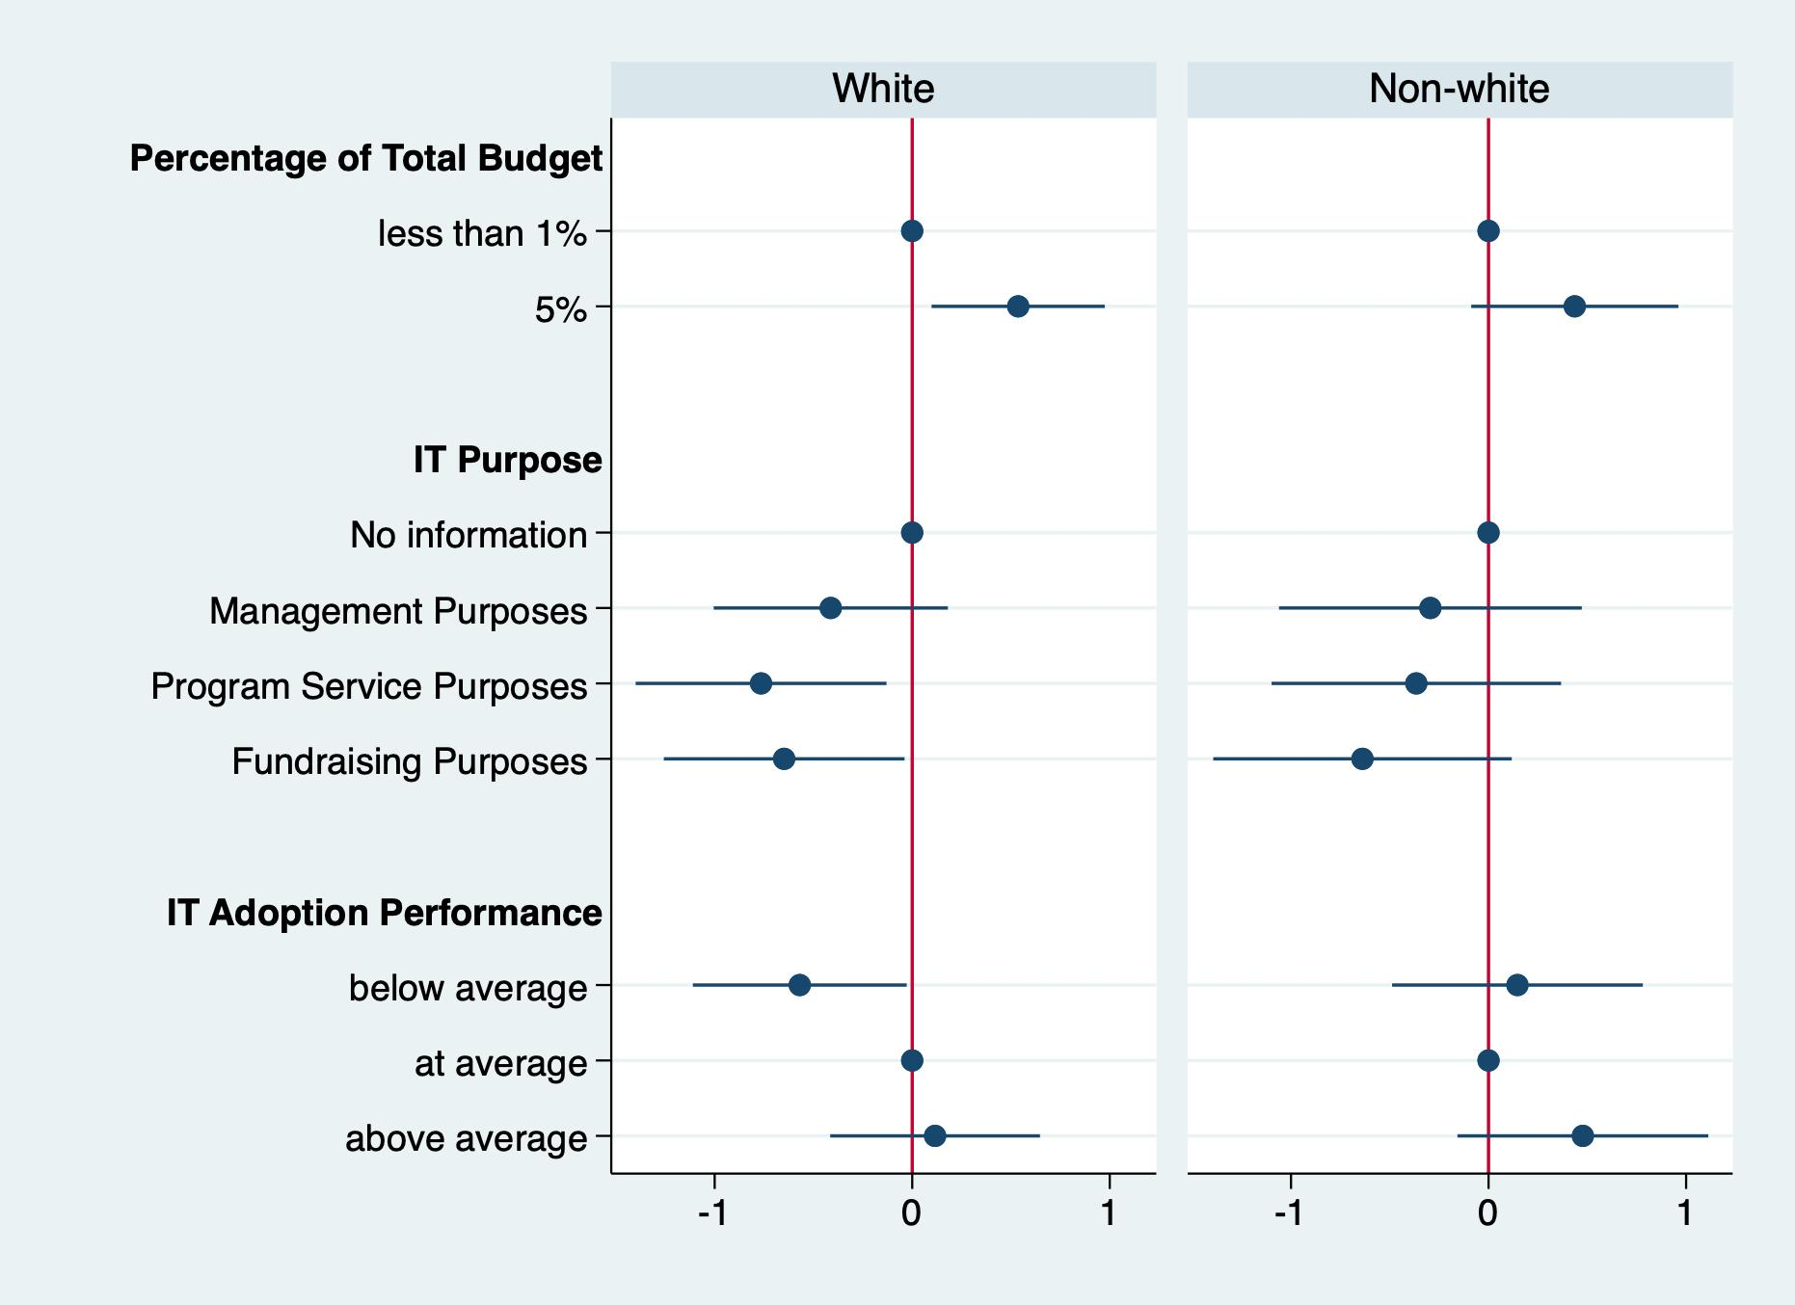

Slide 13
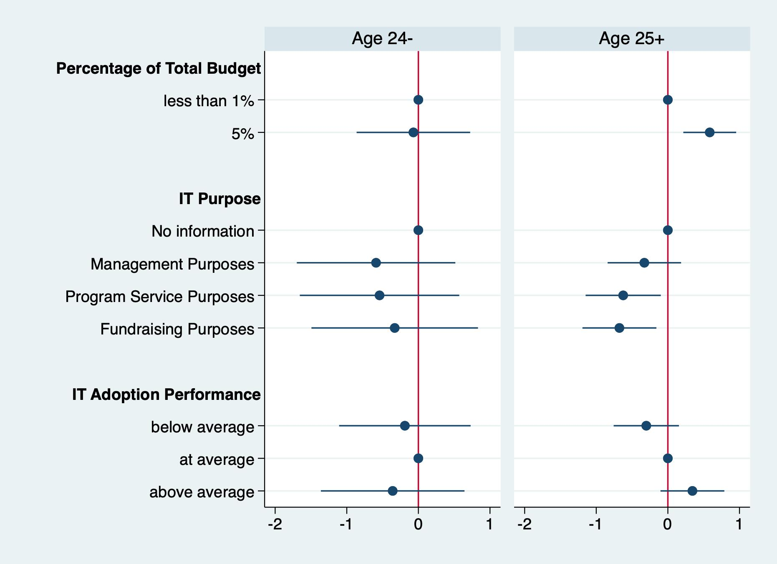
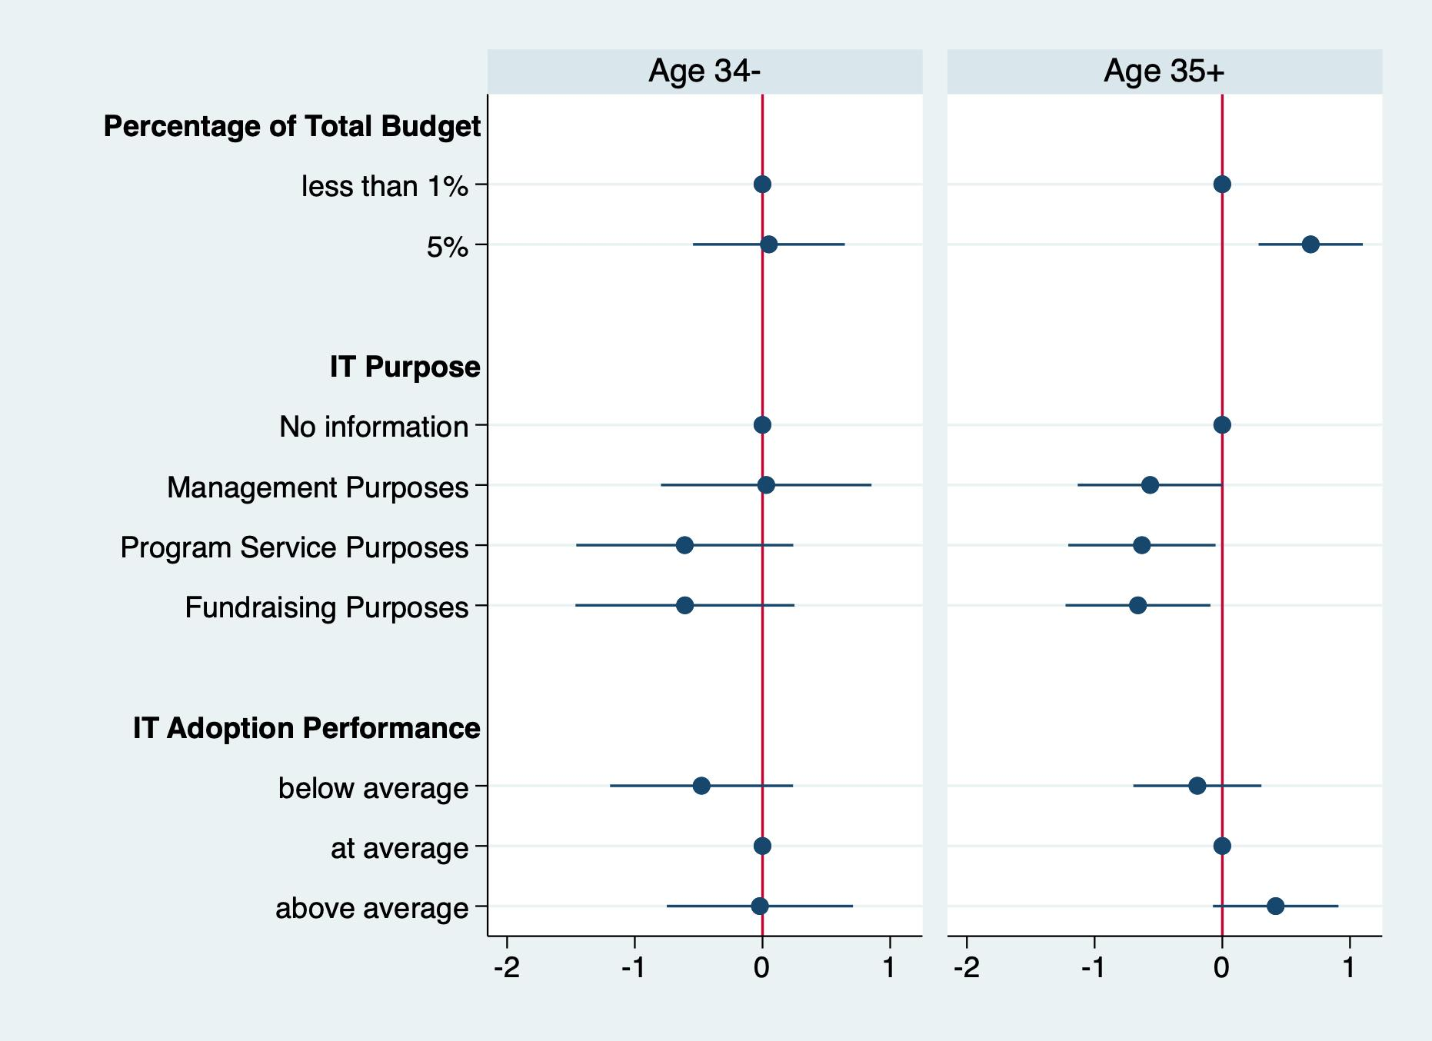
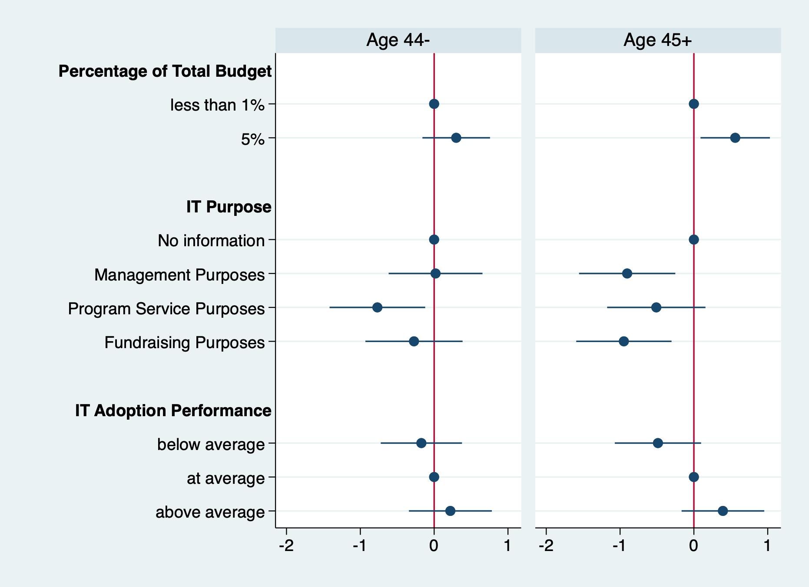
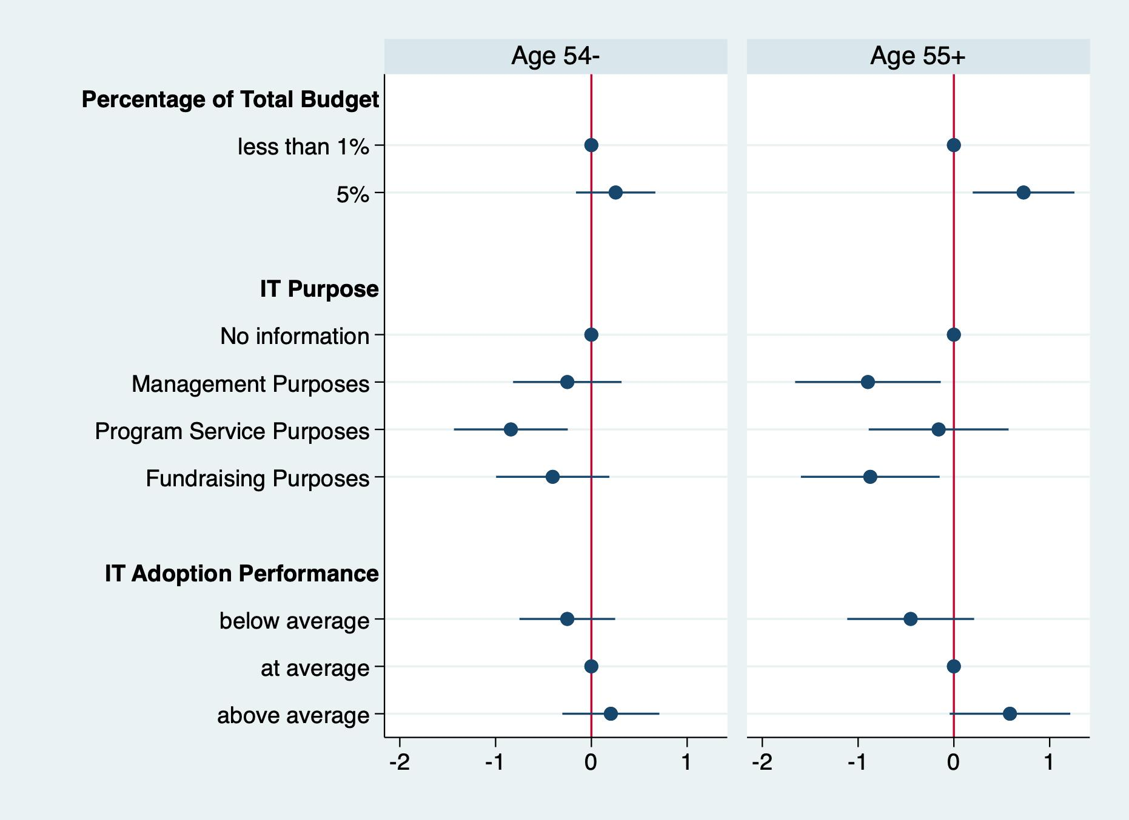
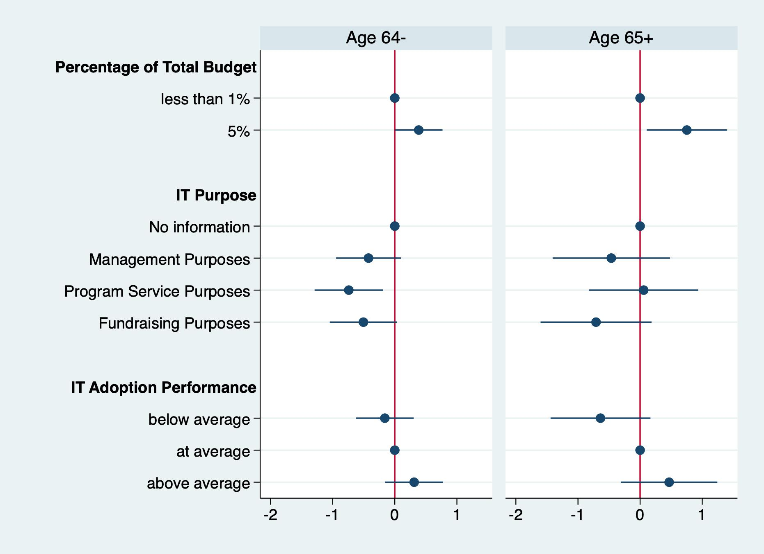

Slide 14
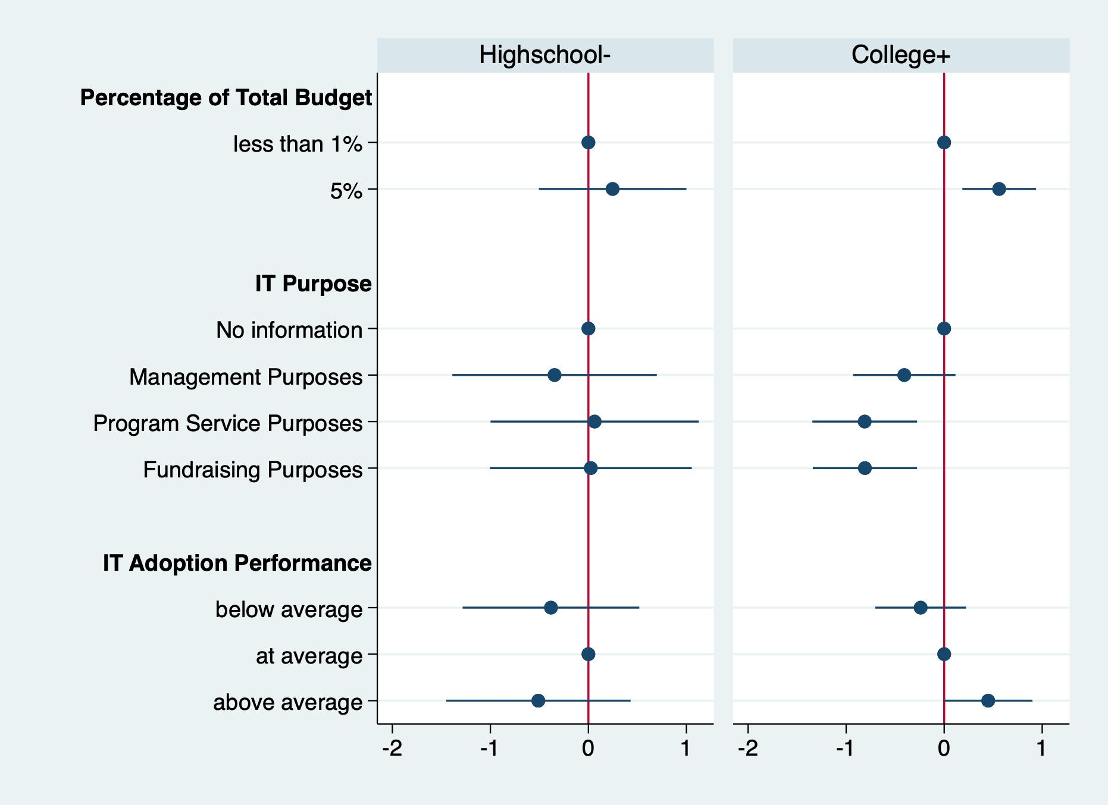

Slide 15
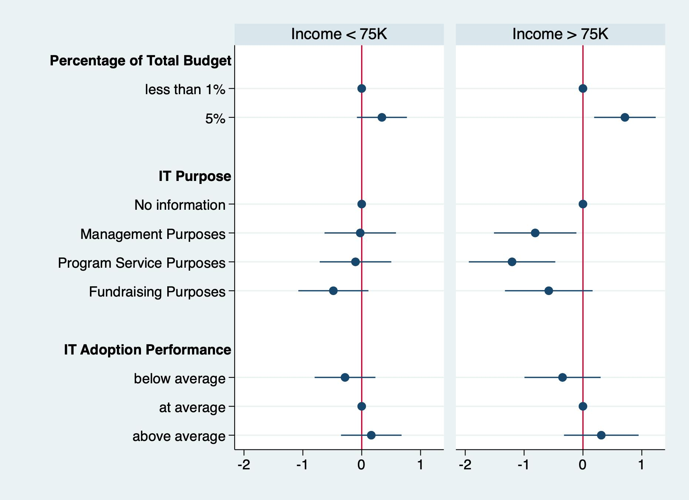

Slide 16
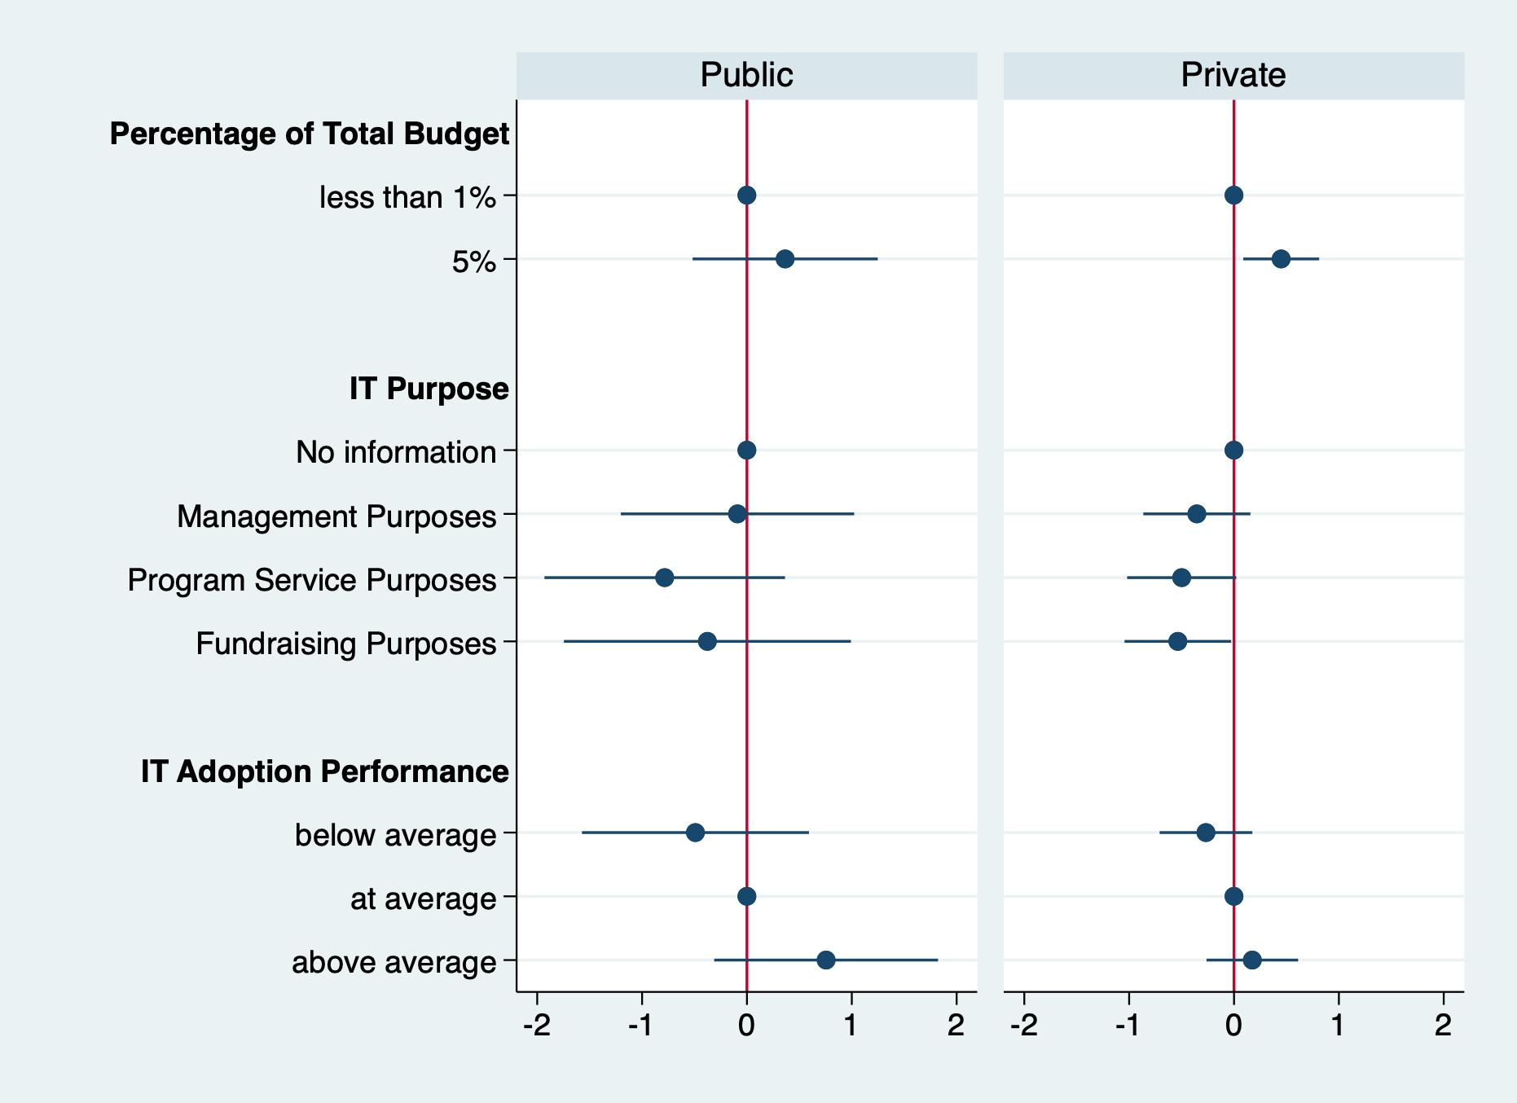
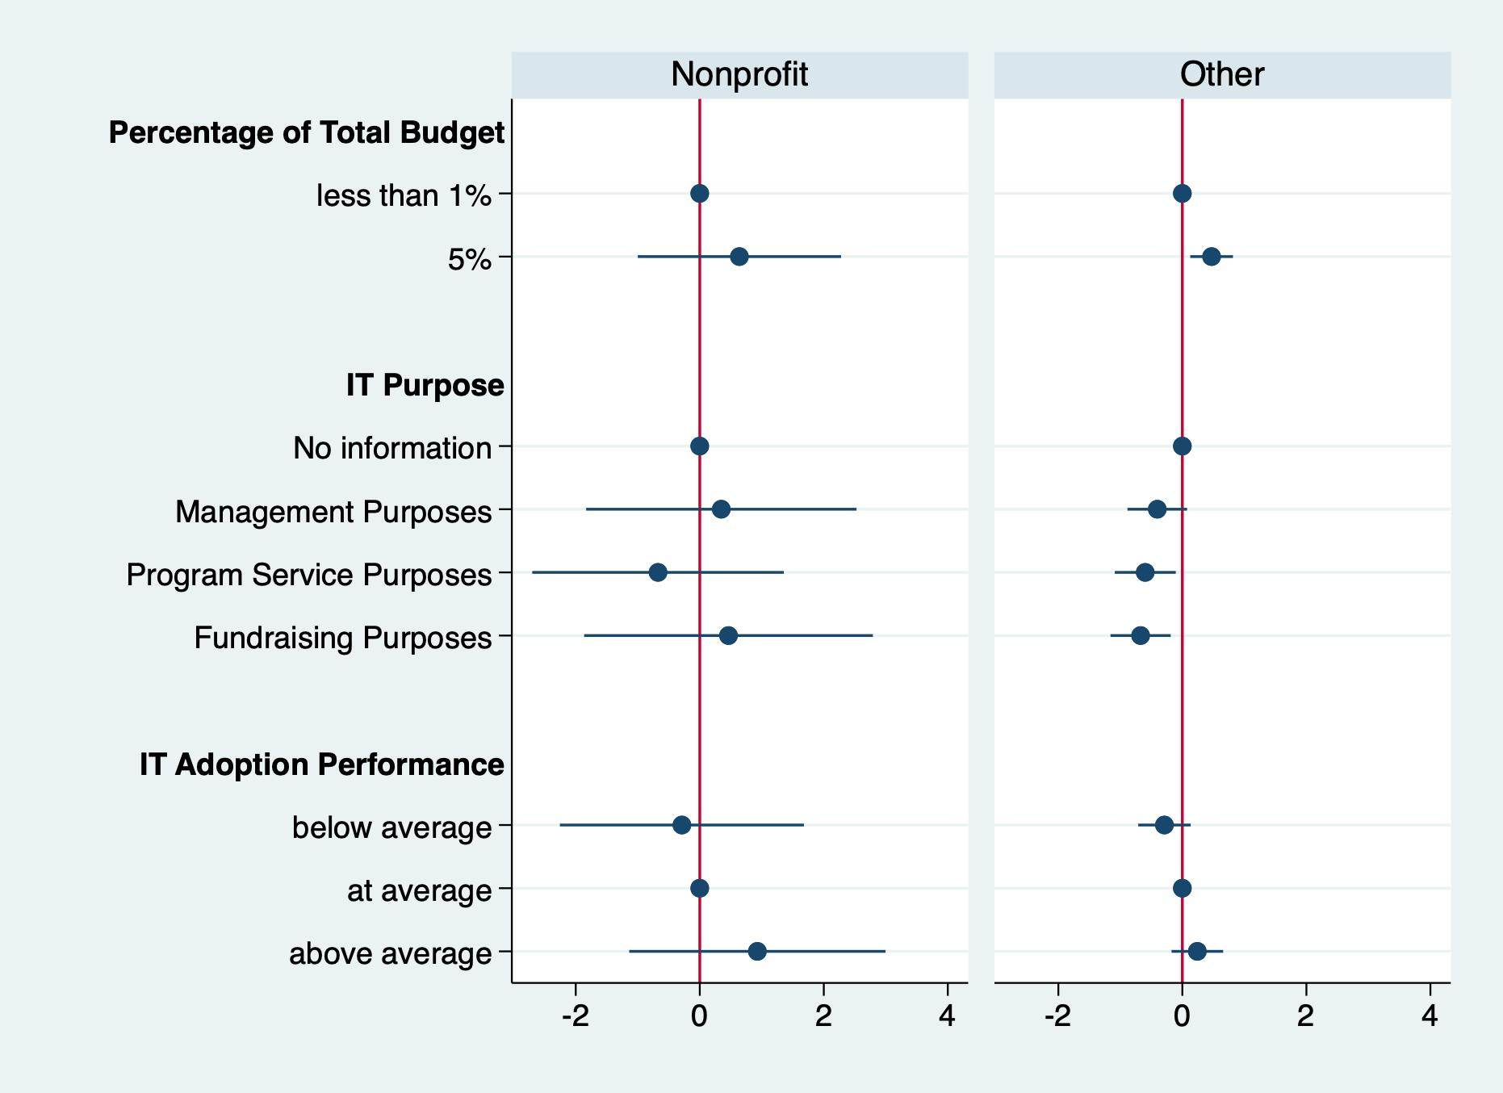

Slide 17
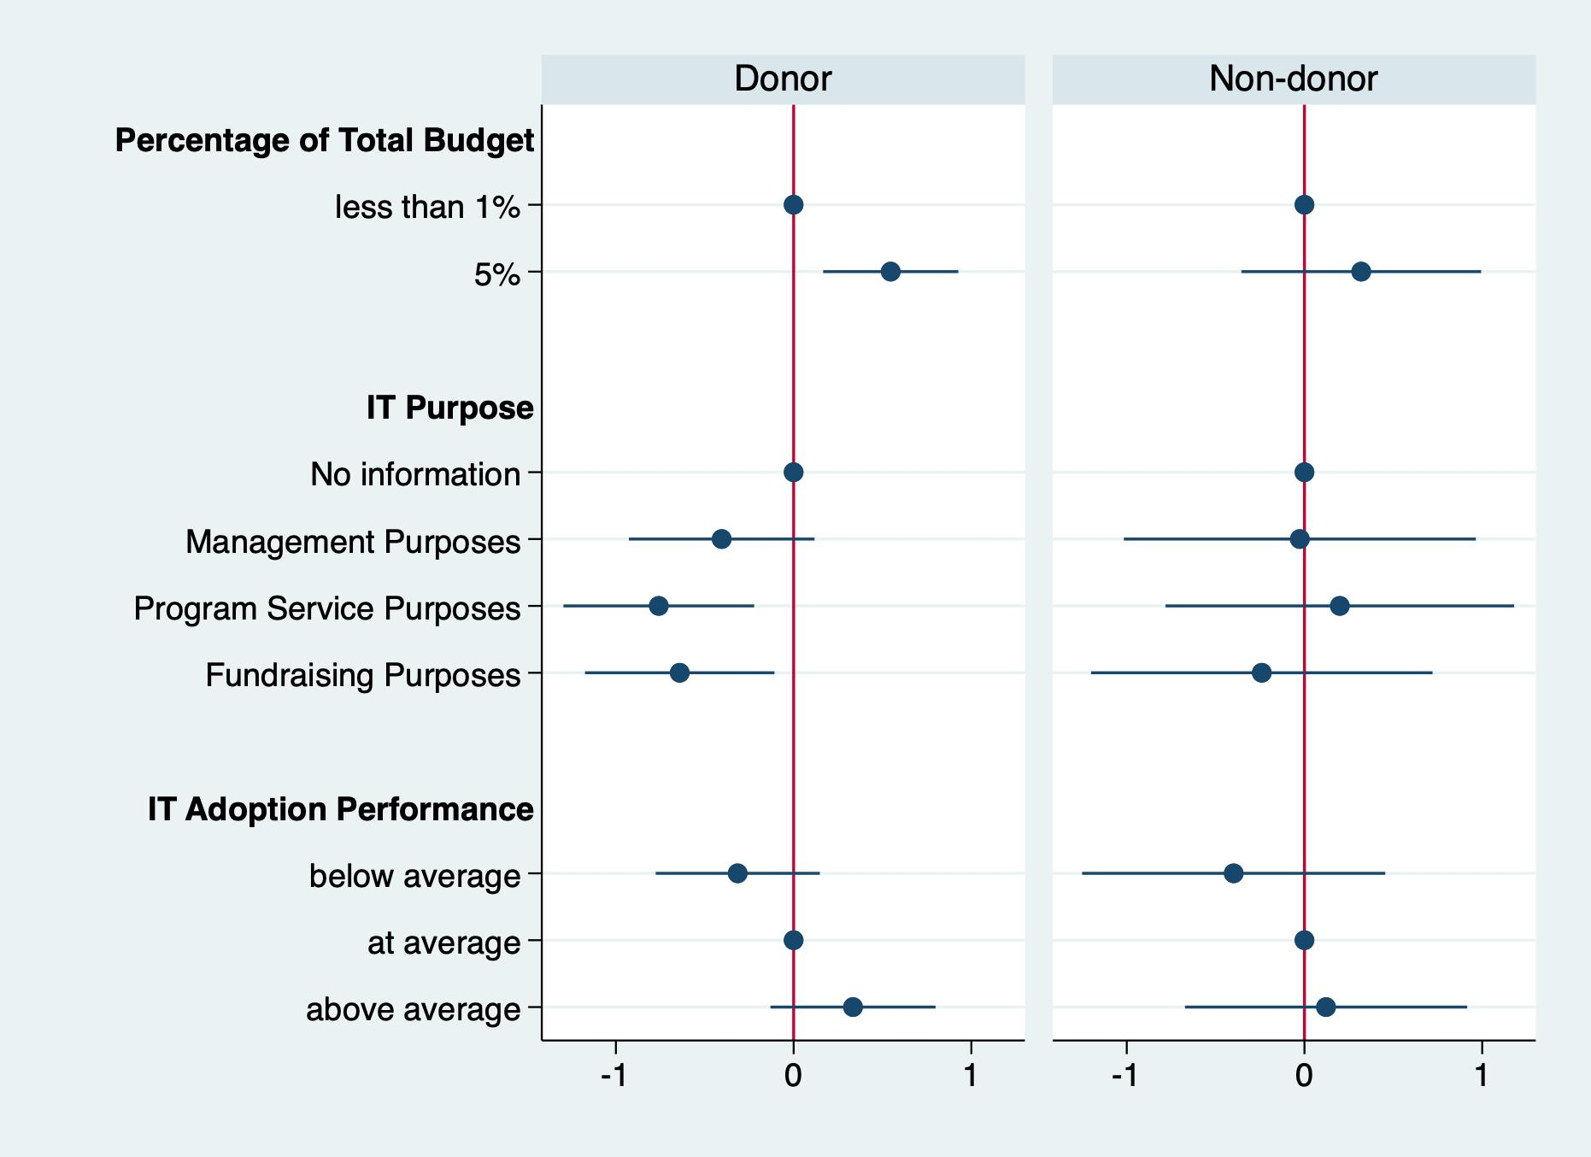

Slide 18
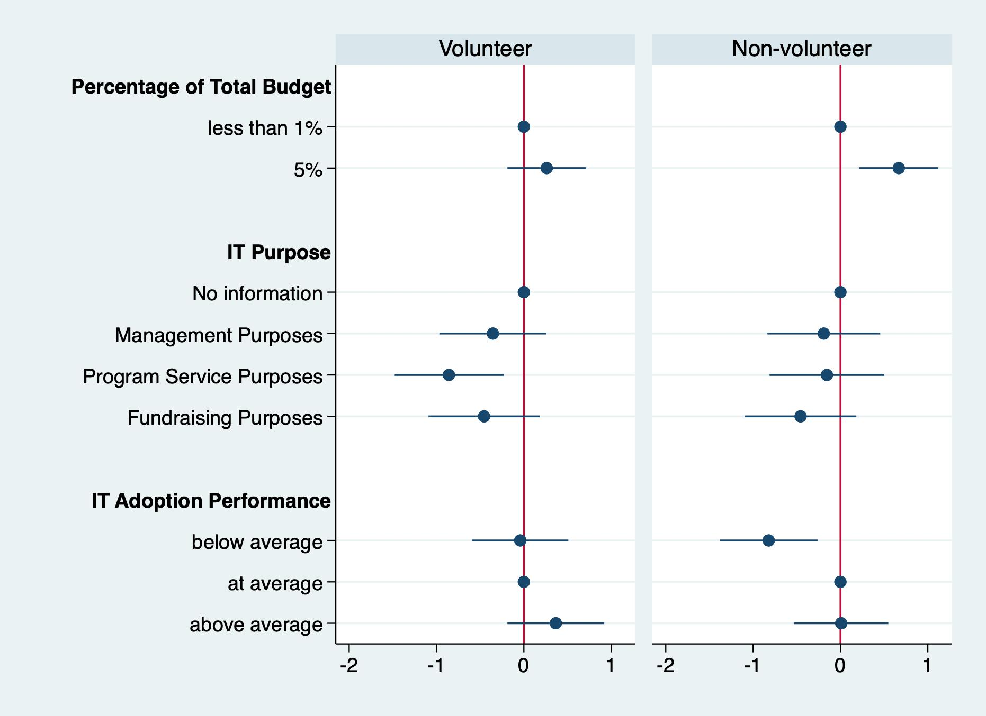

Slide 19
